Slide 1
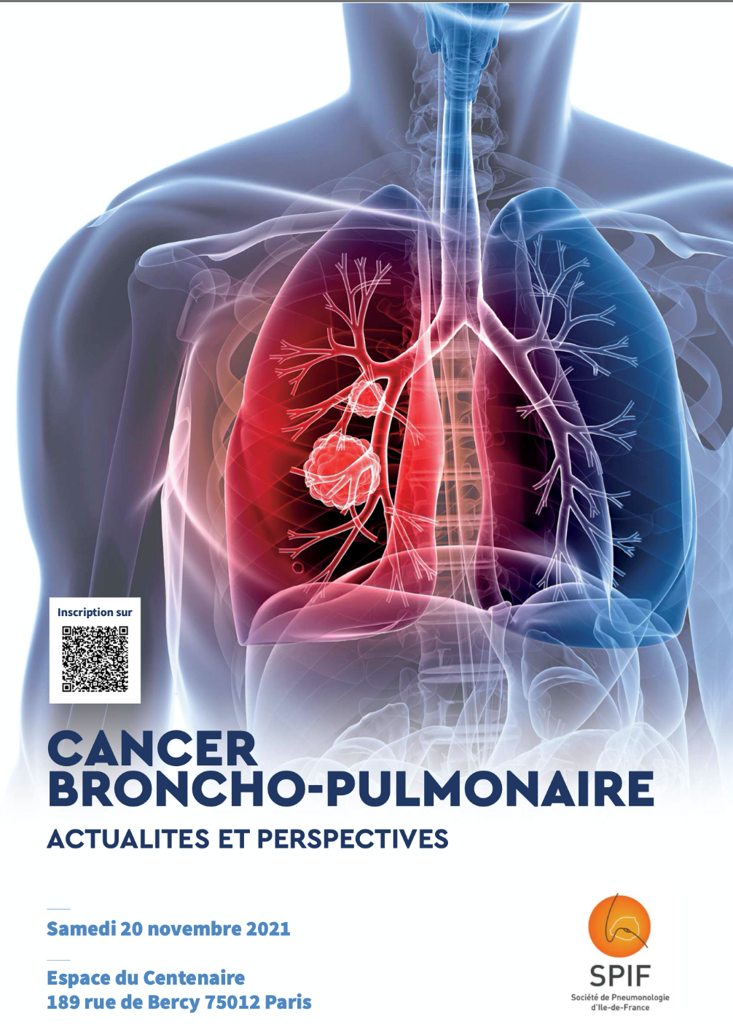
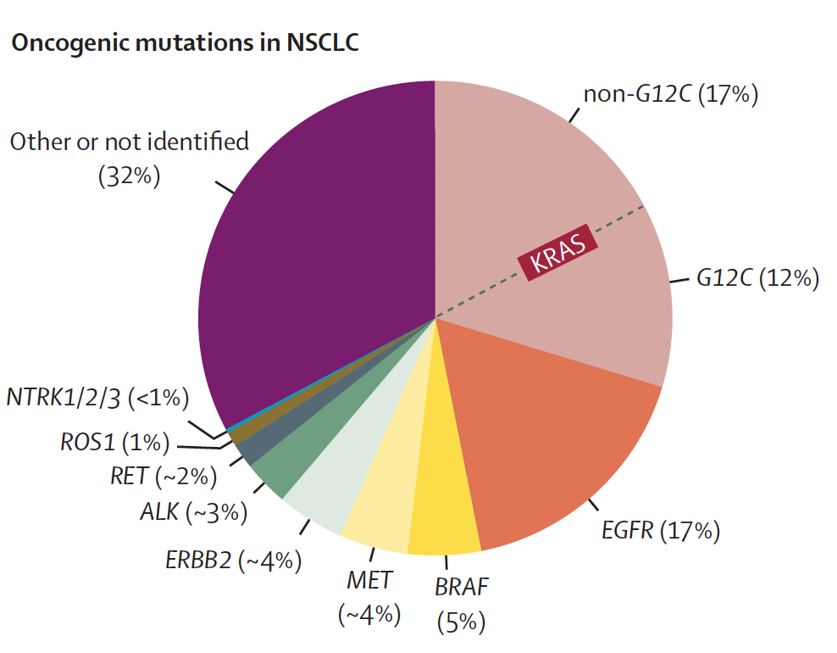
Traitements des CBNPC de stades avancés avec addiction oncogénique – Partie I
EGFR, BRAF, ALK, ROS
THERANOSCAN
GRC-UPMC
Notes:
My talk
is about our current clinical practice of EGFR TKI

Slide 2
Liens d’intérêt :
• Honoraires pour la participation à des réunions d’experts : Astra-Zeneca, BMS, Boerhinger-Ingelheim, Daichi, Jansen, MSD, Novartis, Lilly, Pfizer, Roche, Sanofi, Takeda
• Financement de projets de recherche : AbbVie, Astra-Zeneca, Novartis, Pfizer, SophiaGenetics, Takeda
Liens d’intérêt en relation avec la présentation :
• Honoraires pour la participation à des réunions d’experts : Astra-Zeneca, Boerhinger-Ingelheim, Daichi, Jansen, Novartis, Pfizer, Roche, Takeda
Notes:
My talk
is about our current clinical practice of EGFR TKI

Slide 3
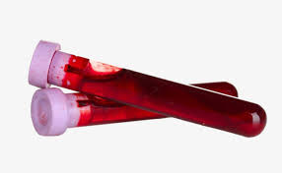
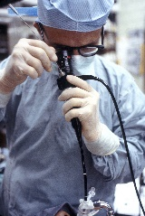
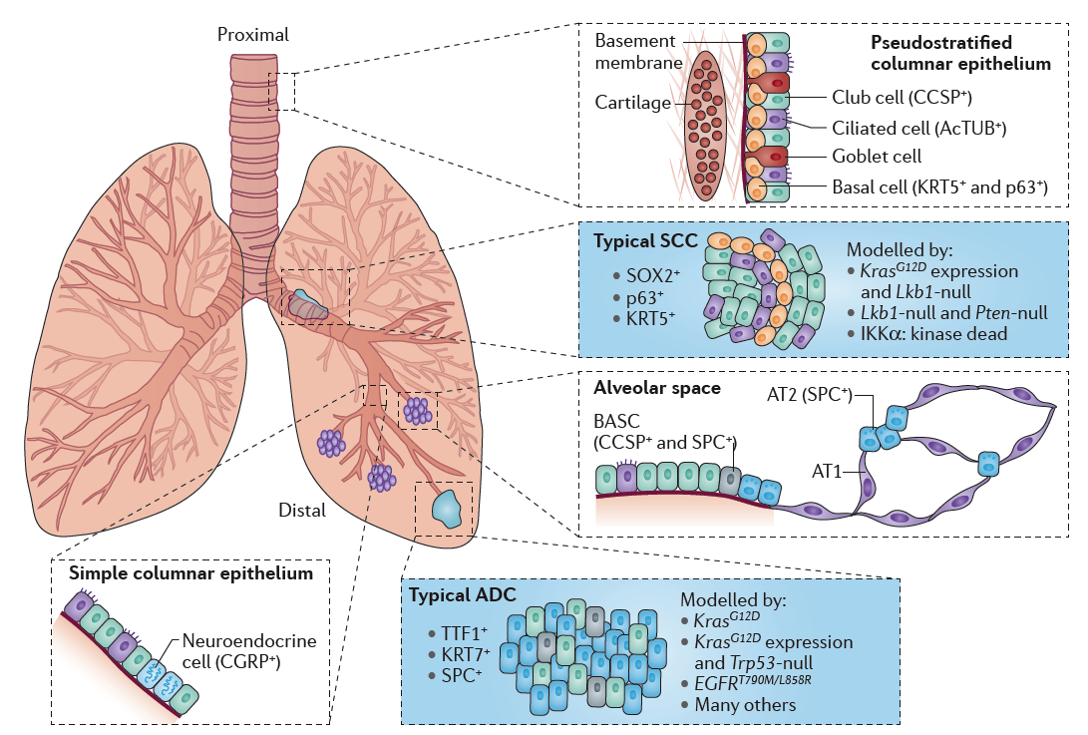
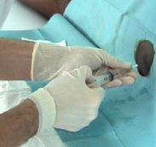
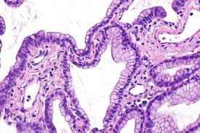
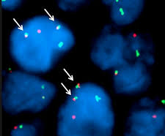
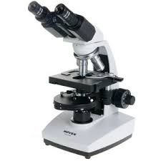
Diagnostic histo-moléculaire des CBNPC étendus
NSCLC
EGFR
ALK/ROS
BRAFV600
RET
METexon14/ampli
HER2
KRAS
NTRK
NRG1…
Genotyping
DNA, RNA
ALK
ROS
(RET, NRG1)
METa, HER2…
ALK
ROS
IHC, FISH
• ADC,
• non squamous NSCLC,
• all NSCLC non smokers, including SqCC
Adapté de Kalemkerian GP, J Clin Oncol 2018, 36:911

Slide 4
EGFR, BRAF, ALK, ROS convergences et divergences
EGFR
ALK
• ≈ 10% in Caucasian, 40% in Asian
• Female more frequent
• Non or former light smoker
• Adenocarcinoma
• Frequent brain metastasis at diagnosis (20-30%) and at disease progression (35-44%)
• ≈ 3-7% general population, Caucasian = Asian
• Female equal male; younger
• Non smoker
• Adenocarcinoma; signet ring morphology
• Frequent brain metastastis at diagnosis (15-40%) and at disease progression (>60%)
BRAF
ROS
• ≈ 0.5-3% general population, Caucasian > Asian?
• Female more frequent (depending of BRAF subtypes)
• Smoker > non smoker (depending of BRAF subtypes)
• Adenocarcinoma; micropapillary
• Less frequent brain metastastis at diagnosis / frequent intrathoracic metastasis
• ≈ 0.5-2% general population, Caucasian = Asian
• Female more frequent; younger
• Non smoker
• Adenocarcinoma; signet ring morphology
• Pneumonic-type; thromboembolism(?)
• Less frequent brain metastastis at diagnosis / progression
• Pemetrexed high responsiveness(?)
Notes:
My talk
is about our current clinical practice of EGFR TKI

Slide 5
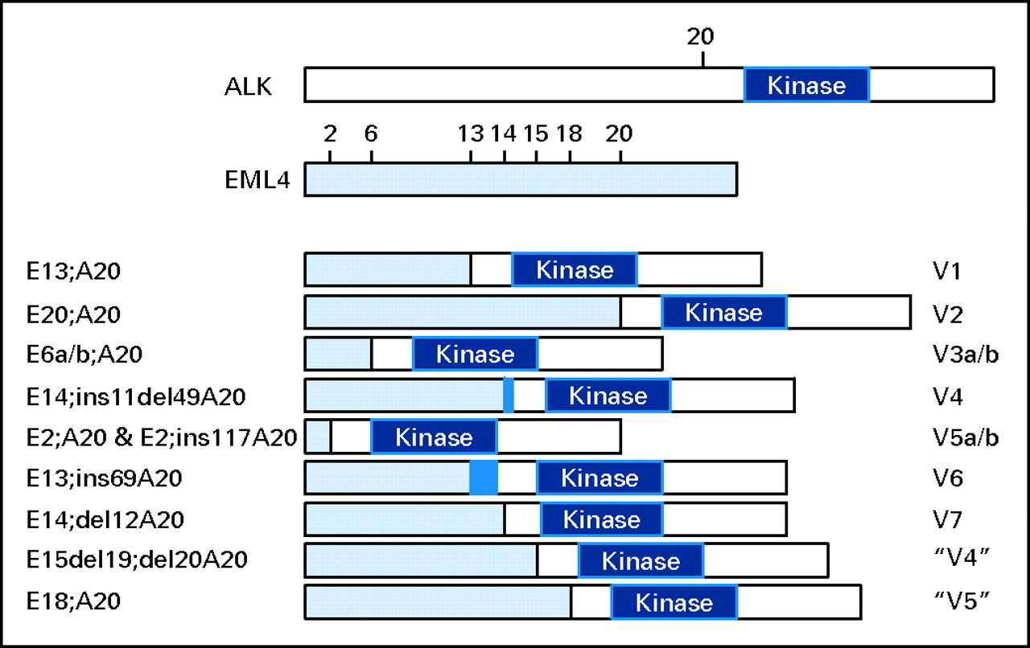
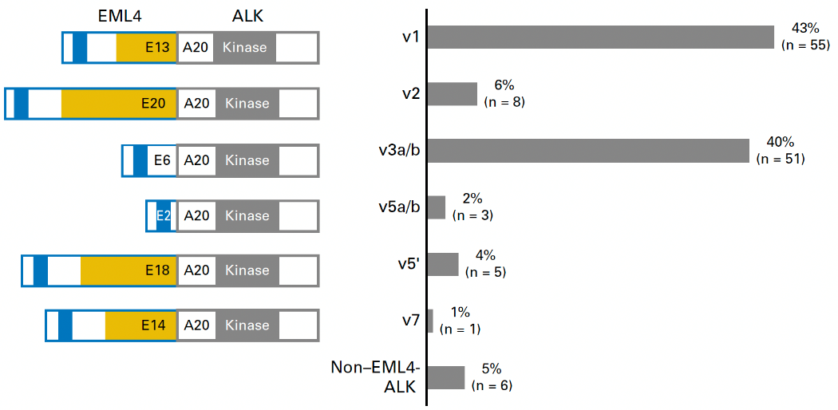
EGFR, BRAF, ALK, ROS convergences et divergences
Impact sur les décisions thérapeutiques : oui, EGFR; non, ALK
EGFR gene tyrosine kinase domain mutations
ALK gene rearrangement with variable partners
Mutation in a kinase domain
Gene rearrangement
in a kinase protein
Exon 19
Biomarqueurs France
(n=1837)
USA Cohort
(n=129)
Exon 21
Protein gain of function
Permanent activation of the fusion kinase protein
Exon 21
38%
>600 mutations
Exon 19
51%
Leduc C, Ann Oncol 2017, 28:2715; Lin J, J Clin Oncol 2018, 36:1199
Notes:
My talk
is about our current clinical practice of EGFR TKI

Slide 6
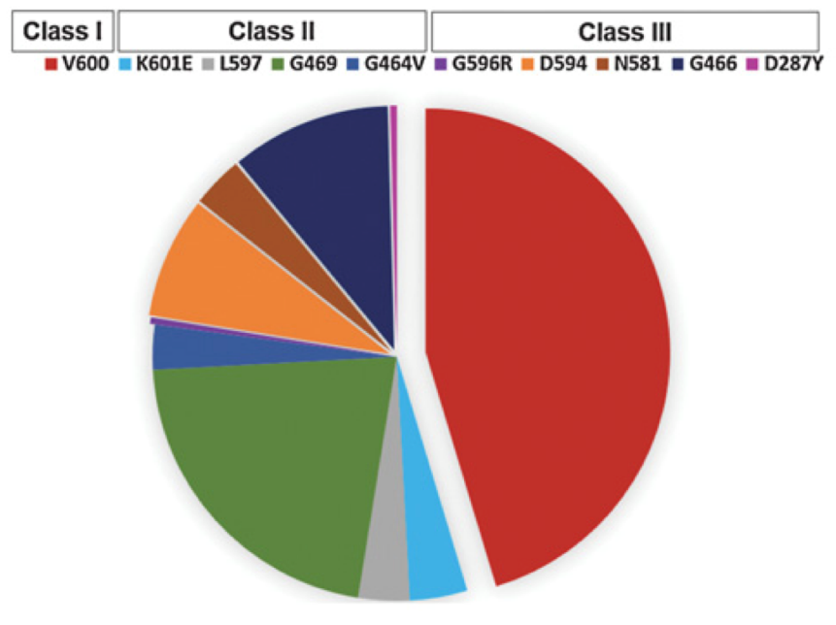
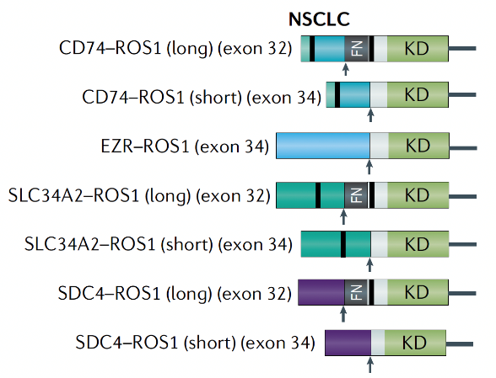
EGFR, BRAF, ALK, ROS convergences et divergences
Impact sur les décisions thérapeutiques : oui, BRAFV600; non, ROS
BRAF gene kinase domain mutations
ROS gene rearrangement with variable partners
Mutation in a kinase domain
ROS1/CD74 rearrangement
USA Cohort
(n=236)
China Cohort
(n=47)
40%
V600E
43%
Never smoker
4.5%
Brain metastasis
30%
Never smoker
22%
Brain metastasis
9%
28%
17%
Dagogo Jack, Clin Cancer Res 2019, 25:158; Drilon A, Nature Rev Clin Oncol 2021, 18:35; Zhang L, Oncotarget 2016, 7:75145
Notes:
My talk
is about our current clinical practice of EGFR TKI

Slide 7
EGFR, BRAF, ALK, ROS convergences et divergences
NSCLC
Weeks
EGFR
ALK/ROS
BRAFV600
RET
METexon14/ampli
HER2
KRAS
NTRK
NRG1…
PD-L1≥50%
Genotyping
DNA, RNA
Days
Weeks
ALK
ROS
(RET, NRG1)
METa, HER2…
ALK
ROS
IHC, FISH
• ADC,
• non squamous NSCLC,
• all NSCLC non smokers, including SqCC
Days
Adapté de Kalemkerian GP, J Clin Oncol 2018, 36:911

Slide 8
EGFR, BRAF, ALK, ROS convergences et divergences
PD-L1
≥50%
Relationship between oncogene alteration and PD-L1 expression
Days
?
Mucinous/signet ring ADC
Female
Asian
Non smoker; light/former smoker
(No need for emergency treatment)
n=10 005
?
ROS pos
Molecular testing
Berghoff A, ESMO Open 2019, 4:e000498; Gettinger S, Clin Cancer Res Discov 2016, 22:4539

Slide 9
EGFR, BRAF, ALK, ROS convergences et divergences
Le statut PD-L1 n’impacte par la séquence thérapeutique, y compris si ≥50%
PD-L1
≥50%
Re-biopsy?
Non common
Days
?
Non V600
Mucinous/signet ring ADC
Female
Asian
Non smoker; light/former smoker
(No need for emergency treatment)
?
????
????
• Increased toxicity of TKI and IO associations
• Increased toxicity of TKIs after the IO then TKI sequence
Molecular testing
Mazières J, Ann Oncol 2019, 30:1321; Adderley H, Cancer Immunology Immunotherapy 2021, 70:589

Slide 10
EGFR, BRAF, ALK, ROS convergences et divergences
Les IK sont le standard de traitement de 1ère ligne
Phase III trials comparing 1st generation EGFR TKIs vs CT
Phase III trial comparing crizotinib vs CT
ORR: 74% vs 45%
PFS: 10.9 vs 7.0 months
Better QoL and less toxicities
OS: NR vs 47.5 months
Mutations communes
ORR: 62-85% vs 18-47%
PFS: 9.2-13.1 vs 4.6-6.3 months
Better QoL and less toxicities
OS: 19.3-34.8 vs 19.5-37.3 months
Recondo G, Nature Rev Clin Oncol 2018, 15:694

Slide 11
EGFR, BRAF, ALK, ROS convergences et divergences
Les IK sont le standard de traitement de (1ère) ligne
Phase II non comparative trials with crizotinib
Phase II non comparative trials with dabrafenib/trametinib
ORR: 65-72%
PFS: 19.0-24.7 months
OS: 51.4 months
ORR: 63%
PFS: 8.6-10.9 months
OS: 24.6 months
Drilon A, Nature Rev Clin Oncol 2021, 18:35; Bustamante Alvarez JG, Drugs in Context 2019, 8:212566

Slide 12
EGFR, BRAF, ALK, ROS convergences et divergences
Stratégie thérapeutique chez les malades avec addiction
CNS progression vs oligo vs systemic progression
Oncogenic addiction
Resistance
by plasma or tissue biopsy
Treatment compliance
Drug/herbs interaction
Smoking
TKI A
First generation
Beyond progression
Loco-regional treatment
Notes:
Ces chiffres correspondent au cpc et cbnpc, je me restreindrais à l’étude ces CBNPC
Témoignant de la gravité de la maladie
45 222 nouveaux cas estimés en 2015 (30 401 hommes et 14 821 femmes)
Âge médian au diagnostic : 66 ans chez l’homme, 65 ans chez la femme
Taux d'incidence entre 2005 et 2012 : -0,3 % par an en moyenne chez l’homme, +5,4 % par an en moyenne chez la femme
30 555 décès par cancer du poumon estimés en 2015 (20 990 hommes et 9 565 femmes)
Âge médian au moment du décès : 68 ans chez l’homme, 67 ans chez la femme
Taux de mortalité entre 2005 et 2012 : -2,2 % par an en moyenne chez l’homme et +4,6 % par an en moyenne chez la femme
Survie nette standardisée sur l’âge à 5 ans : 17 % (16 % chez l’homme, 20 % chez la femme) ; à 10 ans : 10 % (9 % chez l’homme, 13 % chez la femme)

Slide 13
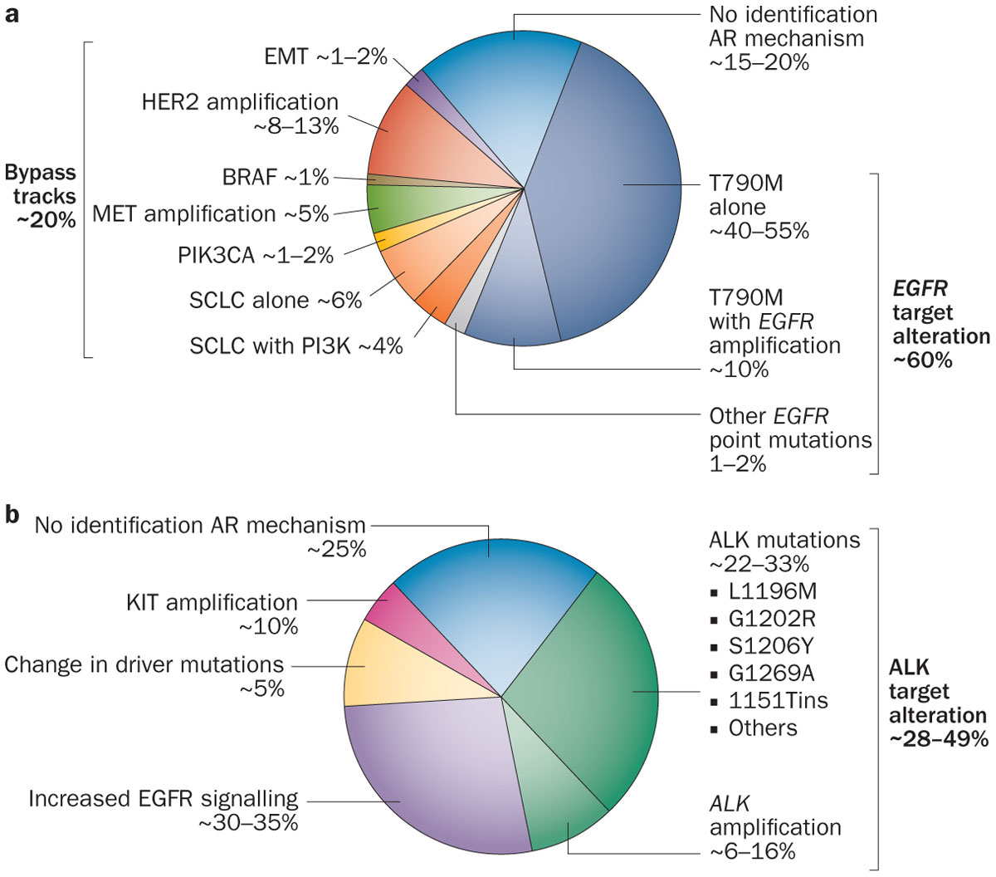
EGFR et ALK convergences et divergences
EGFR molecular resistance, 1st/2nd generation TKIs
ALK molecular resistance, crizotinib
Include also loss of ALK rearrangement
Less frequent T790M selection in the CNS
More MET alterations (amplification, HGF expression)
EMT, small cell and sarcomatoid transformation
Impact sur les décisions thérapeutiques : oui pour EGFR,? pour ALK
Camidge R, Nat Rev Clin Oncol 2014, 11:473; Gainor JF, Cancer Discov 2016, 6:1118
Notes:
My talk
is about our current clinical practice of EGFR TKI

Slide 14
EGFR, BRAF, ALK, ROS convergences et divergences
Stratégie thérapeutique chez les malades avec addiction
CNS progression vs oligo vs systemic progression
Oncogenic addiction
Resistance
by plasma or tissue biopsy
Oncogenic dependent mechanisms
Non oncogenic dependent mechanisms
Treatment compliance
Drug/herbs interaction
Smoking
TKI A
First generation
TKI B
Second generation
TKi “n”
Next generation
Chemotherapy
±Bevacizumab
±ICI
Beyond progression
Loco-regional treatment
Decreased oncogenic dependency
Increased tumor heterogeneity
Notes:
Ces chiffres correspondent au cpc et cbnpc, je me restreindrais à l’étude ces CBNPC
Témoignant de la gravité de la maladie
45 222 nouveaux cas estimés en 2015 (30 401 hommes et 14 821 femmes)
Âge médian au diagnostic : 66 ans chez l’homme, 65 ans chez la femme
Taux d'incidence entre 2005 et 2012 : -0,3 % par an en moyenne chez l’homme, +5,4 % par an en moyenne chez la femme
30 555 décès par cancer du poumon estimés en 2015 (20 990 hommes et 9 565 femmes)
Âge médian au moment du décès : 68 ans chez l’homme, 67 ans chez la femme
Taux de mortalité entre 2005 et 2012 : -2,2 % par an en moyenne chez l’homme et +4,6 % par an en moyenne chez la femme
Survie nette standardisée sur l’âge à 5 ans : 17 % (16 % chez l’homme, 20 % chez la femme) ; à 10 ans : 10 % (9 % chez l’homme, 13 % chez la femme)

Slide 15
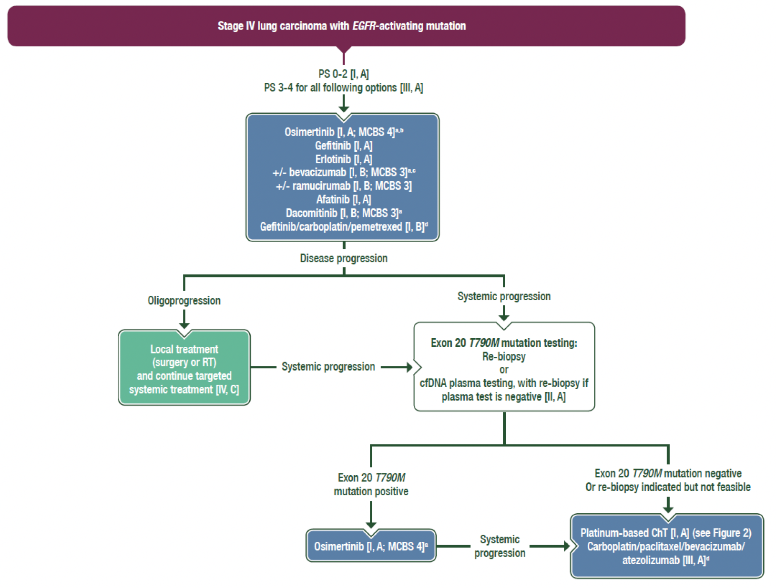
Evolution des séquences thérapeutiques – algorithme pour EGFR
Mutations communes
•
• Approuvés par EMA
• ESMO Option
• Non remboursés en France
• Approuvé par EMA
• Option EMA
• Non remboursé en France
• Approuvé par EMA
• ESMO Option
• Non remboursé en France
•
•
•
•
AURA, NEON, NOCOBFC, ONCORIF
Planchard D, Clinical Practice Guidelines ESMO 2020
Notes:
There was however several limitations

Slide 16
Evolution des séquences thérapeutiques – algorithme pour EGFR
Avant l’ère osimertinib…
Phase III/IIb trials evaluating 1st vs 2nd generation EGFR TKIs in 1st line treatment
•
•
Karachaliou N, Transl Cancer Res 2019, 8:S23; Yang JJ, BJC, 2017, 116:568; Park K, Lancet Oncol 2016,17:577; Wu YL, Lancet Oncol 2017, 18:1454; Mok T, J Clin Oncol 2018, 36:2244
Notes:
There was however several limitations

Slide 17
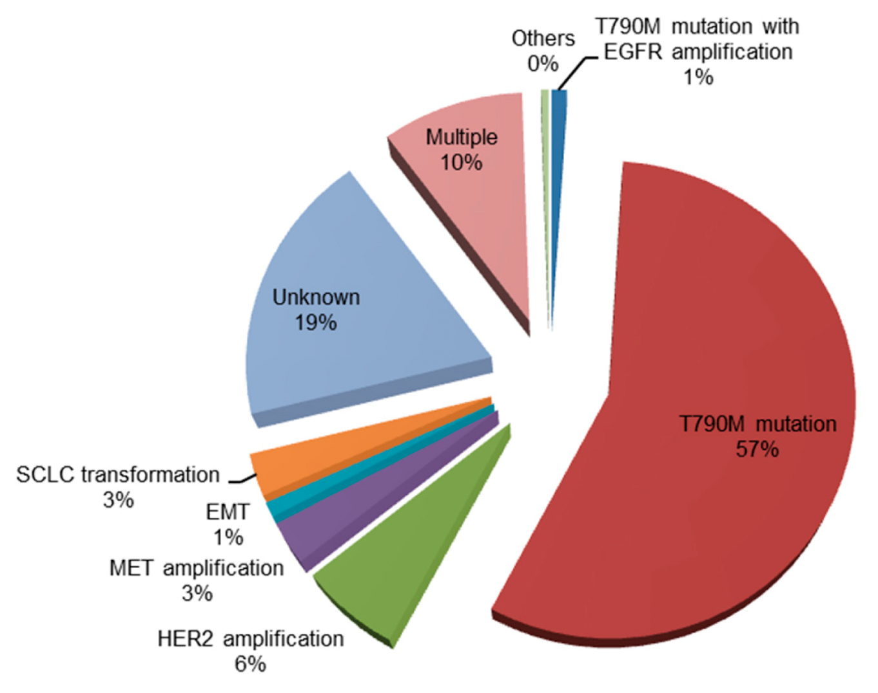
Evolution des séquences thérapeutiques – algorithme pour EGFR
Avant l’ère osimertinib…
Molecular resistance after 1st/2nd generation TKI
≈10 months
PD-L1?
Nagano T, Cells 2018, 212:1; Schmid S, Lung Cancer 2020, 147:123
Notes:
This strategy has been prospectively evaluated in the ASPIRATION trial and results to a 3 more
months exposure to the TKI
However, the two arms were not randomized and the most interesting findings of this trial are
the differencies between the two groups.
In the group in which TKI was maintained the PFS1………

Slide 18
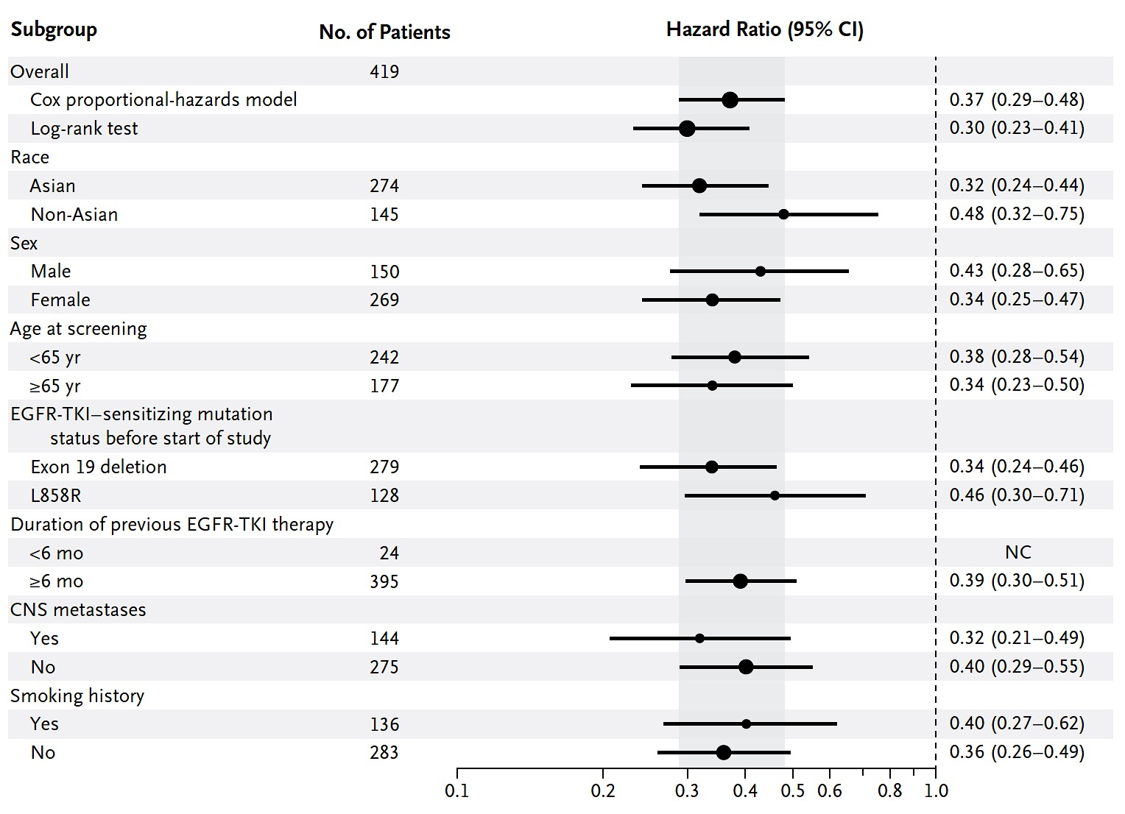
Evolution des séquences thérapeutiques – algorithme pour EGFR
Avant l’ère osimertinib, T790M+…
AURA 3 Phase III trial osimertinib vs platinum pemetrexed, 2nd line treatment of EGFR NSCLC
All patients with T790M mutation after 1st line EGFR TKI, amendment for osimertinib cross-over
Better QoL and less toxicities
Mok TS, N Engl J Med 2017, 16:376

Slide 19
Evolution des séquences thérapeutiques – algorithme pour EGFR
Avant l’ère osimertinib, T790M négatif/inconnu…
PFS
IMpower 150 Phase III trial, 1st line treatment of all comers NSCLC
Carboplatin paclitaxel plus becacizumab (BCP) or atezolizumab (ACP) or atezolizumab plus bevacizumab (ABCP)
Subgroup analysis in EGFR driven NSCLC after or not EGFR-TKI (n=123)
• Which proportion of T790M mutation after TKI progression?
OS
Similar frequency of ≥3 grade toxicities, with increased proportion of irAE in ABCP vs ACP arm
Reck M, Lancet Respir Med 2019, Epub

Slide 20
Evolution des séquences thérapeutiques – algorithme pour EGFR
Avant l’ère osimertinib…
Diffuse progression
plasma and/or tissue biopsies
Common EGFR mutation
Stage IV NSCLC
(age <75 year/old, PS ≤2, no comorbidity)
EGFR-TKI
gefitinib, erlotinib, afatinib
1L
Oligo-progression
Pharmacology?
increase dose
change TKI?
TKI
beyond progression
T790M+
osimertinib
T790M-/ADC
platinum doublet
± bevacizumab
SCLC
(T790M + or -)
ddp etoposide
TKI pursuit?
Other alteration Trials/
molecular boards
PDL1 +
ICI?
≥2L
T790M-/ADC
Carbo-placlitaxel
+ beva + atezo
Planchard D, Annales Oncol 2018, 29:192; Planchard D, Annales Oncol 2019, Epub; Référentiel AURA 2020

Slide 21
Evolution des séquences thérapeutiques – algorithme pour EGFR
Depuis l’ère de l’osimertinib…
FLAURA Phase III 1st line treatment, osimertinib vs gefitinib/erlotinib
Advanced NSCLC, common EGFR mutation, double blind, amendment for osimertinib cross-over
Less toxicities
Soria JC, N Engl J Med 2018, 378:113

Slide 22
Evolution des séquences thérapeutiques – algorithme pour EGFR
Depuis l’ère de l’osimertinib…
FLAURA Phase III 1st line treatment, osimertinib vs gefitinib/erlotinib
Advanced NSCLC, common EGFR mutation
Overall survival
L’osimertinib est l’ITK de choix en 1ère ligne
Ramalingam S, ESMO 2019

Slide 23
Evolution des séquences thérapeutiques – algorithme pour EGFR
Depuis l’ère de l’osimertinib…
Diffuse progression
plasma AND tissue biopsies
Common EGFR mutation
Stage IV NSCLC
(age <75 year/old, PS ≤2, no comorbidity)
Osimertinib
1L
Oligo-progression
Pharmacology?
increase dose
change TKI?
TKI
beyond progression
All/no molecular alterations
platinum doublet
± bevacizumab
SCLC
ddp etoposide
TKI pursuit?
Other alteration
Trials/
molecular board
PDL1 +
ICI?
≥2L
T790M-/ADC
Carbo-placlitaxel
+ beva + atezo
?

Slide 24
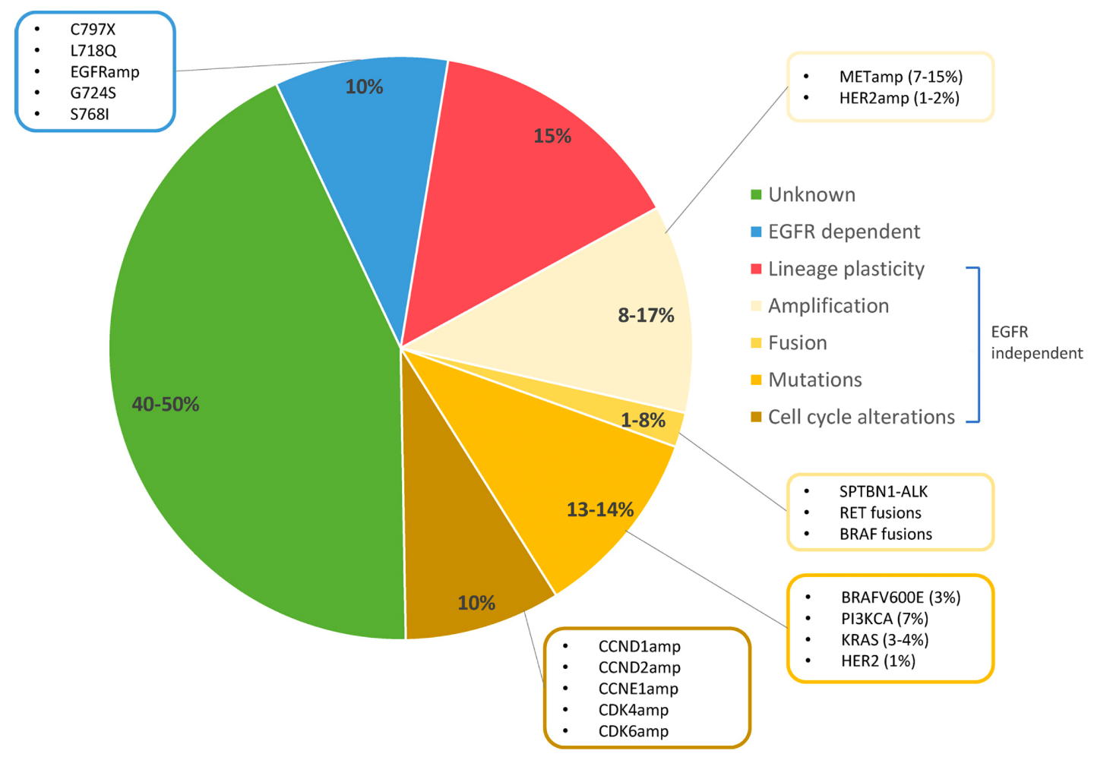
Evolution des séquences thérapeutiques – algorithme pour EGFR
Molecular resistance after 1st/2nd generation TKI
≈10 months
Molecular resistance after 1st line osimertinib
≈19 months
• Platinum doublet CT ± bevacizumab
- (Carbo-paclitaxel, atezolizumab, bevacizumab)
- IO
• Carboplatine etoposide ± TKI
• Case reports of targeted therapy (ib or ab)
- monotherapy
- combotherapy
- ± osimertinib continuation
• Trials
PD-L1?
PD-L1?
Nagano T, Cells 2018, 212:1; Schmid S, Lung Cancer 2020, 147:123
Notes:
This strategy has been prospectively evaluated in the ASPIRATION trial and results to a 3 more
months exposure to the TKI
However, the two arms were not randomized and the most interesting findings of this trial are
the differencies between the two groups.
In the group in which TKI was maintained the PFS1………

Slide 25
CBNPC mutés pour l’EGFR, traiter la résistance…
Main therapeutic trials for patients osimertinib biomarker driven resistance : MET, C797S, HER2
Main therapeutic trials for patients osimertinib without biomarker driven resistance
Amivantamab
Patritumab deruxtecan
Piper Vallillo AJ, J Clin Oncol 2020, epub June

Slide 26
CBNPC mutés pour l’EGFR, retarder la résistance…
patients perdus
EGFR-ITK 1^{ére} gén.
19,5-35,5 mo. (8 études)
NS vs. Doublet de platine
9,2-13,6 mo.
patients perdus
Osimertinib
(vs. erlotinib/gefitinib)
38,1 mo.
HR: 0,799 (0,641-0,997), p=0,0462
18,9 mo.
patients perdus
Erlotinib+bevacizumab
Erlotinib+ramucirumab
(vs. erlotinib)
36,2-50,7 mo. (1 phase III RAMU, 2 phase III +2 phases II BEVA)
NS pour BEVA (Phases II et III)
16,0-19,7 mo.
patients perdus
HR: 0,70 (0,52-0,93), p=0,013
HR: 0,45 (0,31-0,65), p=0,0001
Gefinitib+carboplatin-
pemetrexed/pemetrexed
(vs. gefitinib)
50,9-NR mo. (2 études)
16,0-20,9 mo.
0
10
20
30
40
50
Survie sans progression/Survie globale (mois)

Slide 27
Evolution des séquences thérapeutiques – algorithme pour EGFR
Pour les mutations rares…
• Afatinib better than CT (1)/G719 exon18, S768I exon20
• Afatinib better than 1st generation EGFR TKI (2)
• Osimertinib efficacy (3)/L861Q exon 21
• Osimertinib authorization to use
• CT > TKIs
• Poziotinib (4)
• TAK 788 (5)
• Avimantamab (met-egfr) (6)
• Osimertinib 160 mg (7)
• Patritumab deruxtecan (her3 conj) (8)
Masood A, Seminars in Oncology Epub September 2019; 1) Yang JC Lancet Oncol 2015,16:830;
2) Shen Y, Lung Cancer 2017,110:56; 3) Cho JH, J Thorac Oncol 2018,13:S344 ; 4) Heymach J, J Thorac Oncol 2018, WCLC;
5) Neal J, J Thorac Oncol 2018, WCLC; 6) Park K, ASCO 2020; 7) Piotrowska Z, ASCO 2020; 8) Zer A, ESMO 2020
Notes:
This therapeutic recommendation is based on at least 7 phase 3 trials
Most patients were from asian countries; except for the EURTAC trial exclusively in caucasian and 1/3 third patients of LuxLung3 trial
Common and rare mutations were usually included; well distinguish in the LUX programme
Three with gefitinib, 2 with erlotinib and 2 with afatinib
Chemotherapy were doublet platinum with taxans in gefitinb programme; erlo and afa were compared with platin gem
and afa also with platin pem. Chemotherapy were various in EURTAC trial
Results were concordant within all trials. Objective response rate >60% with a 80% disease control rate. PFS more than 9.5 mo peaking up to 13.5 mo with afatinib in common mutations. More than 50% of reduction risk of progression

Slide 28
Evolution des séquences thérapeutiques – algorithme pour EGFR
Pour les insertions Exon 20…
 | Osimertinib ^{[61]} (n=21) | Poziotinib ^{[63]} (n=87) | Mobocertinib ^{[59,60]} (2 essais ; n=210) | CLN-081 ^{[62]} (n=43) | DZD9008 ^{[65]} (2 essais ; n=56) | Amivantamab ^{[64]} (n=81)
Molécule Dose | ITK 3^{éme} génération 160 mg/j | ITK spécifique 16 mg/j | ITK spécifique 160 mg/j | ITK spécifique 30-65-100 mgx2/j | ITK spécifique 200 mg ou 300 mg/j | Anticorps anti-EGFR/MET 1050-1400 mg/2 semaines
Critères d’inclusion Méta. cérébrales | ≥ 2ème ligne Stables ?% | Après CT Stables 10% | Après CT Actives 35% | Après CT/ITK Stables ?% | Après CT/ITK Stables 43% | Après CT 22%
Post ITK/n ligne | ?/n=2 | 25%/ ? | 25-35% | Post ITK : 18% ; post osimertinib : 20% ; post poziotinib : 9% | Post ITK : 45-46% poziotinib, mobocertinib, amivantanab 2 à 3 lignes | 25%
Post IO | ? | ? | 34 -43% | 55% | 30-34% | 46%
Toxicités >30% | diarrhées 76% ; cytopénie ; mucite ; rash | diarrhées 79% ; rash ; mucite ; paronychies | diarrhées 91-93%, rash, paronychies | rash 73% | diarrhées 54%, rash 40%, nausées ou vomissements | réaction perfusion 66% ; rash ; paronychies
Réduction dose/arrêt | ?/5% | 68%/10% | 22-25%/10-17% | 11%/9% | 16-50%/0-40% | 13%/4%
RO | 24% | 15% | 25-28% | 31% ; 46% à 100 mg x 2/jour | 39,6% (n=56) | 40%
SSP/Durée Ttt Survie globale | 9,6 mois/ ? ? | 4,2 mois/7,4 mois ? | 7,3 mois/17,5 mois 24 mois | 4,2 mois/7,4 mois ? | ?/8+ mois (n=56) ? | 8,3 mois/11,3 mois 22,8 mois
Progression SNC | ? | ? | 38% | ? | ? | ?
Effet selon insertion | ? | Similaire | Similaire | Similaire | Similaire ? | Similaire
Notes:
This therapeutic recommendation is based on at least 7 phase 3 trials
Most patients were from asian countries; except for the EURTAC trial exclusively in caucasian and 1/3 third patients of LuxLung3 trial
Common and rare mutations were usually included; well distinguish in the LUX programme
Three with gefitinib, 2 with erlotinib and 2 with afatinib
Chemotherapy were doublet platinum with taxans in gefitinb programme; erlo and afa were compared with platin gem
and afa also with platin pem. Chemotherapy were various in EURTAC trial
Results were concordant within all trials. Objective response rate >60% with a 80% disease control rate. PFS more than 9.5 mo peaking up to 13.5 mo with afatinib in common mutations. More than 50% of reduction risk of progression

Slide 29
Evolution des séquences thérapeutiques – algorithme pour BRAFV600
CM-189 trial
BRAF cohort
(n=31)
1st line, Dabra-Trame Phase II trial
(n=36)
CT-IO
(n=410)
CT
(n=210)
ORR
47.6%
18.9%
-
ORR
64%
DCR
84.6%
70.4%
62.9%
DCR
72%
PFS
PD-L1>1%
8.8 mo.
6.1 mo.
4.9 mo.
5.1 mo
7.5 mo.
-
PFS
PD-L1>1%
14.6 mo.
-
•
2nd line, Dabra-Trame Phase II trial
(n=57)
ORR
63%
•
DCR
75.4%
IFCT 1904 Trial
AURA, NEON, NOCOBFC, ONCORIF
PFS
PD-L1>1%
9.7 mo.
-
Planchard D, Clinical Practice Guidelines ESMO 2020; Couraud S, EJC 2019, 116:86; Gandhi L, N Engl J Med 2018, 278:2078
Notes:
There was however several limitations

Slide 30
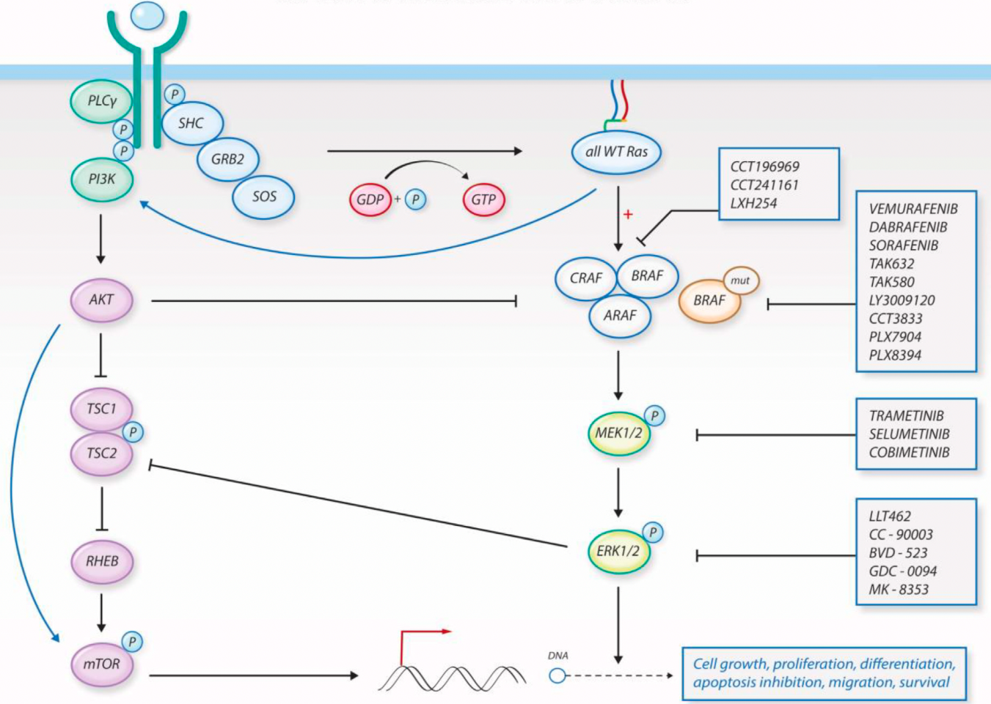
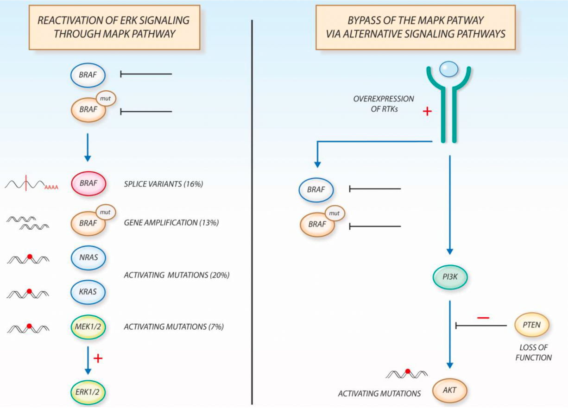
Evolution des séquences thérapeutiques – algorithme pour BRAFV600
Molecules in development for BRAFV600 driven NSCLC
Mechanisms of resistance after exposure to BRAF-MEKi
ENCORAFENIB
Leonetti A, Cancer Treat Rev 2018, 20:82
Notes:
There was however several limitations

Slide 31
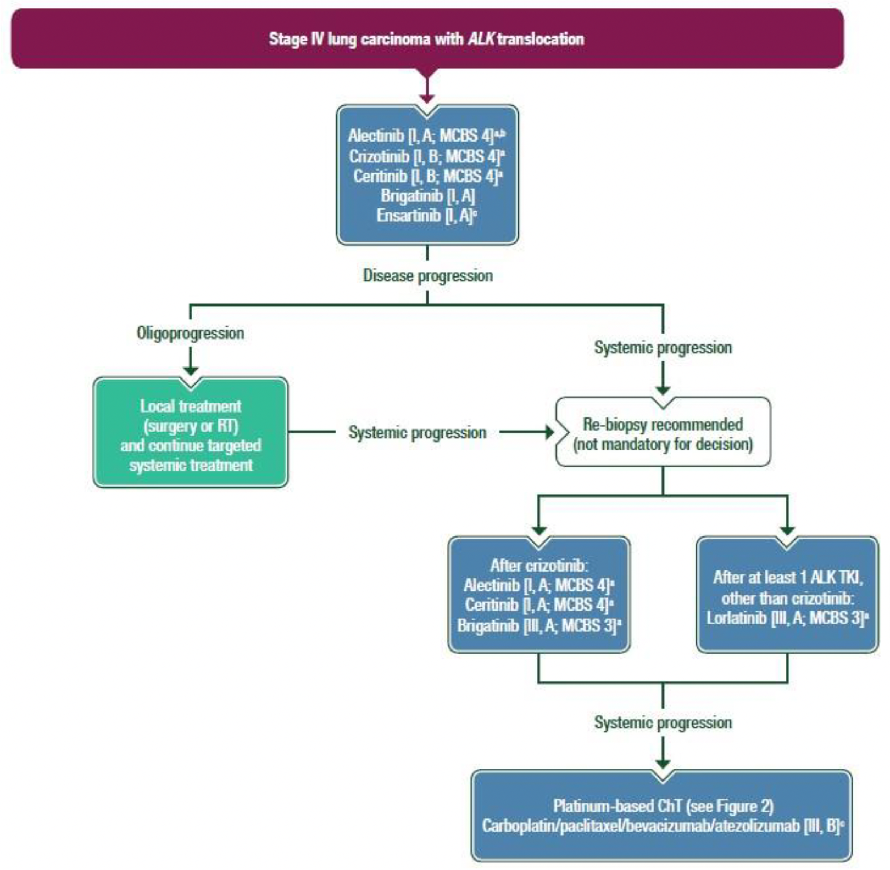
Evolution des séquences thérapeutiques – algorithme pour ALK
•
•
• Approuvé par EMA
• ESMO Option
• Non remboursé en France
•
•
•
•
•
•
•
•
AURA, NEON, NOCOBFC, ONCORIF
Planchard D, Clinical Practice Guidelines ESMO 2020
Notes:
There was however several limitations

Slide 32
Evolution des séquences thérapeutiques – algorithme pour ALK
La meilleure séquence thérapeutique est celle permettant la succession d’ITK
Overall survival from diagnosis of metastatic disease
IFCT 1301 CLINALK cohort
Phase III PROFILE 1014 trial
Next-generation ALKi (n=54)
Subsequent treatment other than ALKi (n=37)
CT followed by ALKi (n=145)
CT followed subsequent treatment other than ALKi (n=3)
89.6 months (53.5-NR)
28.2 months (22.1-33.0)
Duruisseaux M, Oncotarget 2017, 28:21917; Solomon BJ, J Clin Oncol 2018, 22:2251
Notes:
There was however several limitations

Slide 33
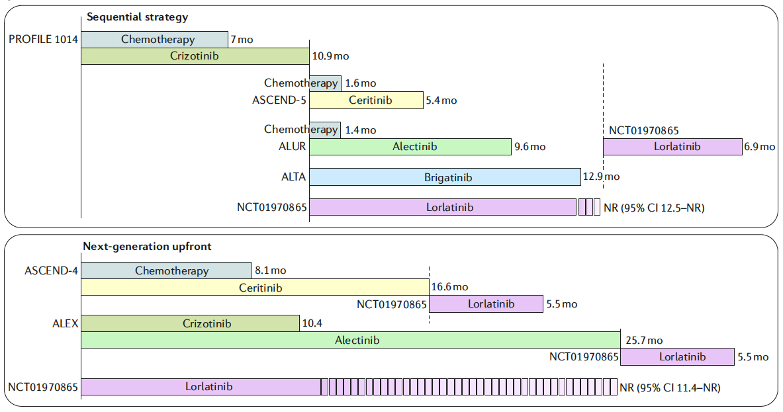
Evolution des séquences thérapeutiques – algorithme pour ALK
Sequential strategy – Comparison of PFS results in selected phase III trials in ALK driven NSCLC
Pemetrexed platinum doublet
Pemetrexed monotherapy
ENS
Ensartinib
Reconda G, Nature Rev Clin Oncol 2018,15:694; Yang Y, Lancet Respir Med 2020, 8:45
Notes:
There was however several limitations

Slide 34
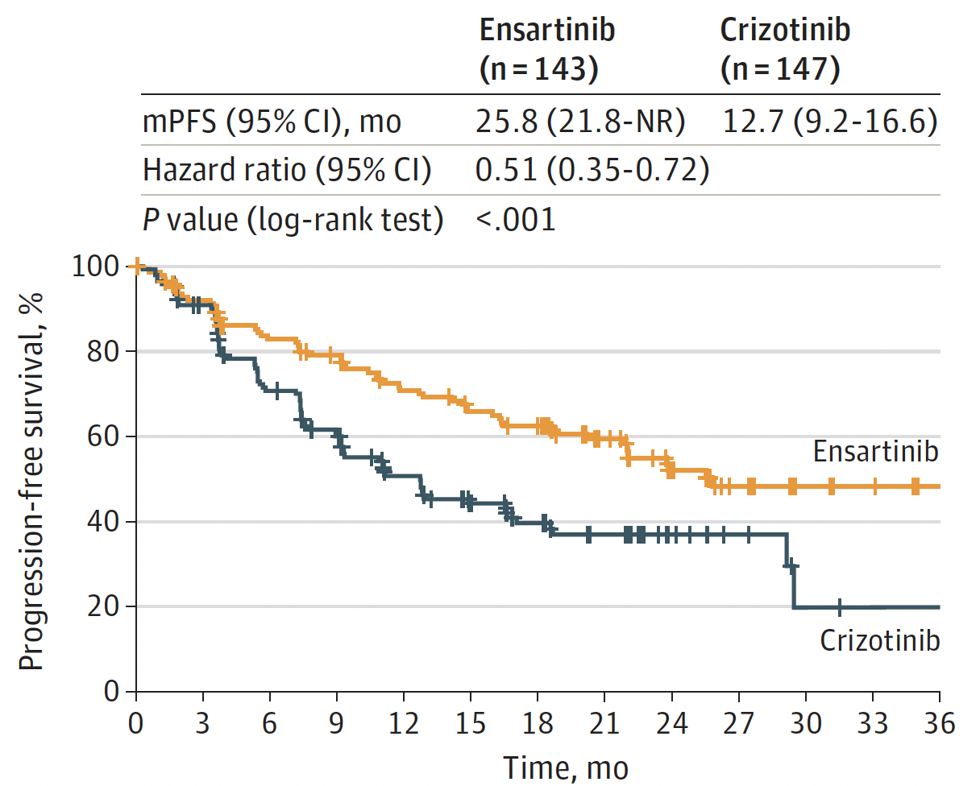
Evolution des séquences thérapeutiques – algorithme pour ALK
Next generation upfront strategy – Comparison of PFS results in selected phase III trials in ALK driven NSCLC
ALEX
ALTA-1L
eXal3-1L
Phase III 1st line trial with alectinib
Phase III 1st line trial with brigatinib
Phase III 1st line trial with ensartinib
IHC ALK; No previous CT; BM 15%
ALK approved test; Previous CT, 25%; BM 29%
FISH ALK; Previous CT, 25%; BM 36%
PFS
PFS
Crizotinib
≈11.0
Crizotinib
≈10.0
Crizotinib
≈12.7
Peters S, N Engl J Med 2017, 377:829; Camidge R, N Engl J Med 2018, 379:2027; Horn L, JAMA Oncol 2021, Epub September

Slide 35
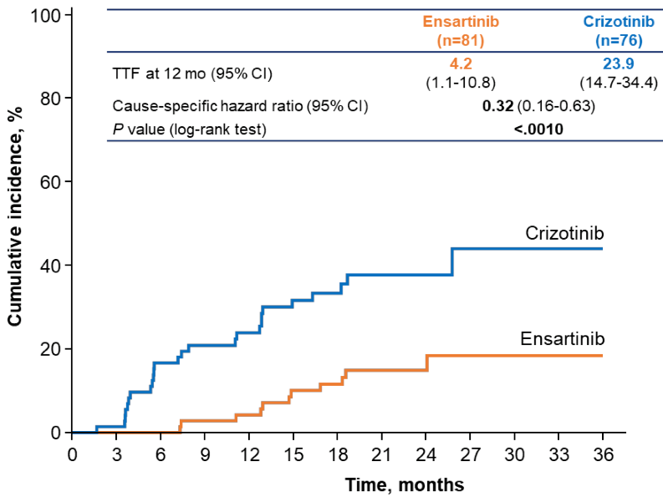
Evolution des séquences thérapeutiques – algorithme pour ALK
Next generation upfront strategy – Comparison of CNS efficacy in selected phase III trials in ALK driven NSCLC
ALEX
ALTA-1L
eXal3-1L
Phase III 1st line trial with alectinib
Phase III 1st line trial with brigatinib
Phase III 1st line trial with ensartinib
IHC ALK; No previous CT; BM 15%
Peters S, N Engl J Med 2017, 377:829; Camidge R, N Engl J Med 2018, 379:2027; Horn L, JAMA Oncol 2021, Epub September

Slide 36
Evolution des séquences thérapeutiques – algorithme pour ALK
La meilleure séquence est de débuter par un ITK 2nd gen à forte pénétration SNC
patients perdus
patients perdus
patients perdus
First-line 2nd generation TKI
ALEX
Alectinib
34.6 mo
ALTA-1
Brigatinib
29.4 mo
Peters S, N Engl J Med 2017, 377:829; Camidge R, N Engl J Med 2018, 379:2027; Camidge R, JTO 2021; Peters S, ASCO 2020

Slide 37
Evolution des séquences thérapeutiques – algorithme pour ALK
Next generation upfront strategy – Comparison of relative ALK-TKI toxicities in selected phase III trials
600 mg bid
180 mg qid
Dagogo-Jack I, ESMO symposium 2021

Slide 38
Evolution des séquences thérapeutiques – algorithme pour ALK
Option 1 sequence: no rebiopsy nor plasma ctDNA for decision making at progression
ALK
Beyond progression
Loco-regional treatment
PFS ≈6 months
Alectinib/Brigatinib
Lorlatinib
Chemotherapy
±Bevacizumab
±ICI

Slide 39
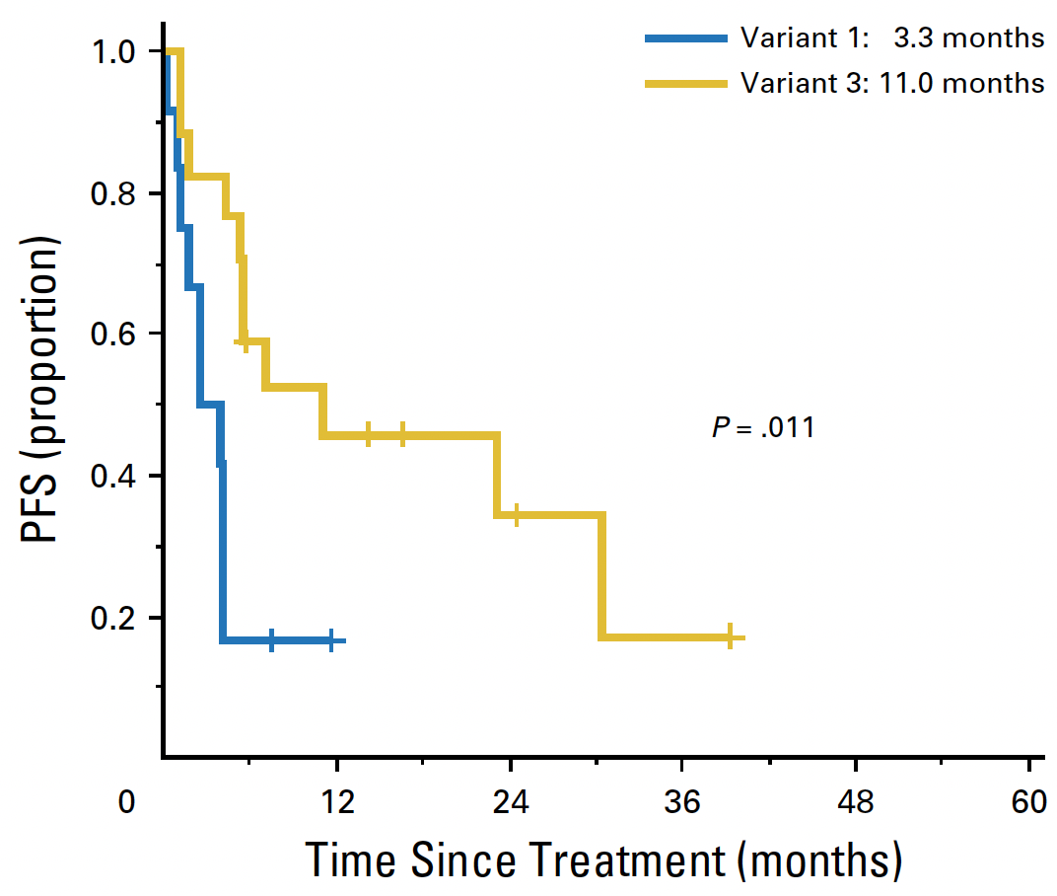
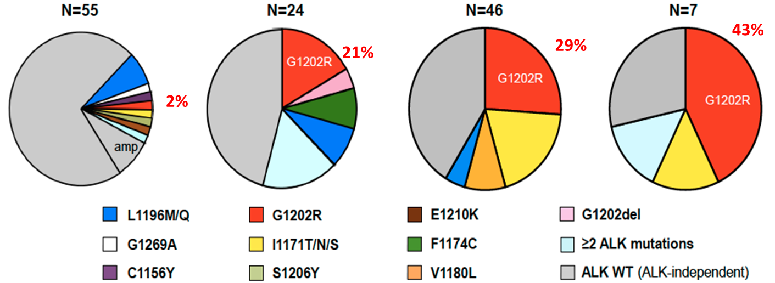
Evolution des séquences thérapeutiques – algorithme pour ALK
ALK dependant resistance mechanism at progression
Ceritinib
Alectinib
Brigatinib
PFS post Lorlatinib
Crizotinib
WT
WT
WT
WT
Gainor JF, Cancer Discov 2016, Epub October; Lin J, J Clin Oncol 2018, 36:1199

Slide 40
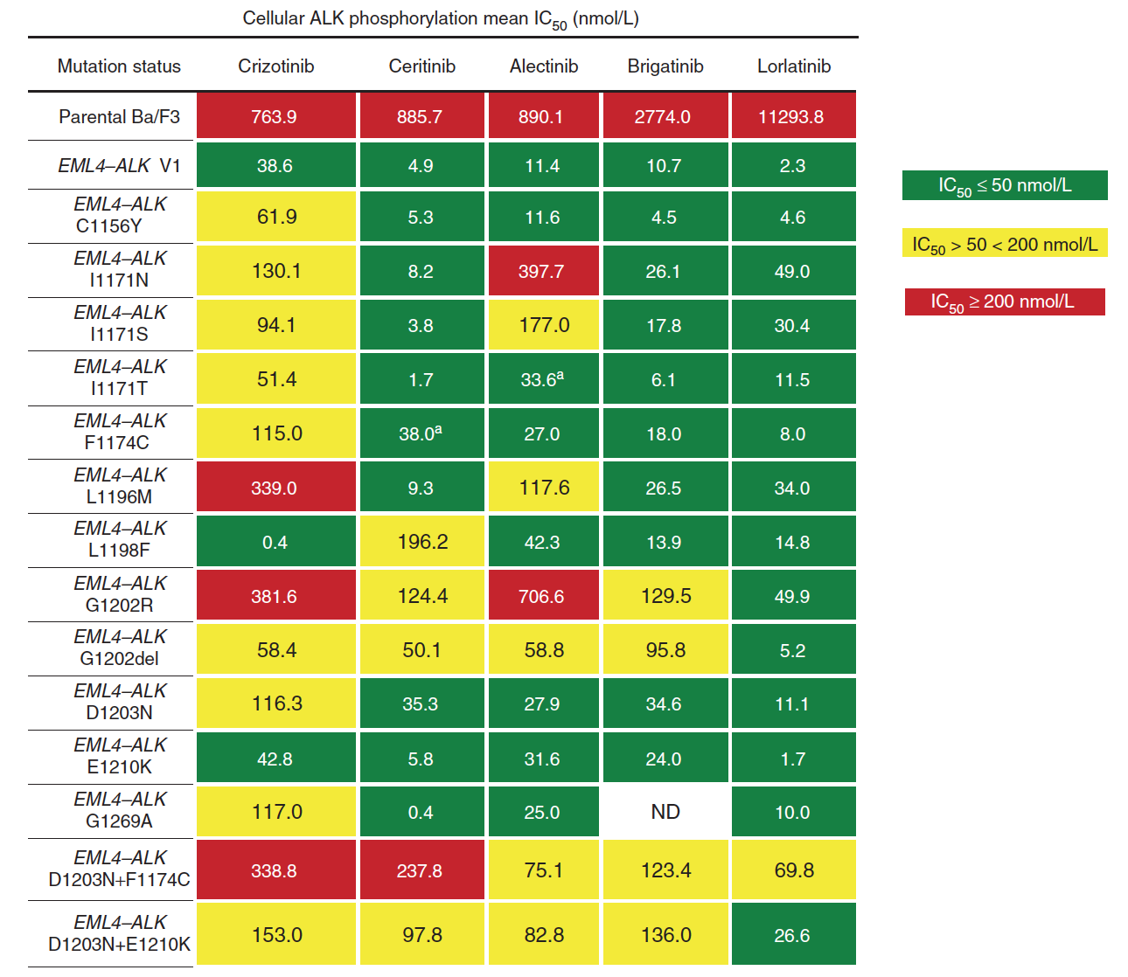
Evolution des séquences thérapeutiques – algorithme pour ALK
ALK dependant resistance mechanism at progression
ALK-ogram for therapeutic strategy?
Crizotinib
Ceritinib
Alectinib
Brigatinib
WT
WT
WT
WT
Gainor JF, Cancer Discov 2016, Epub October;

Slide 41
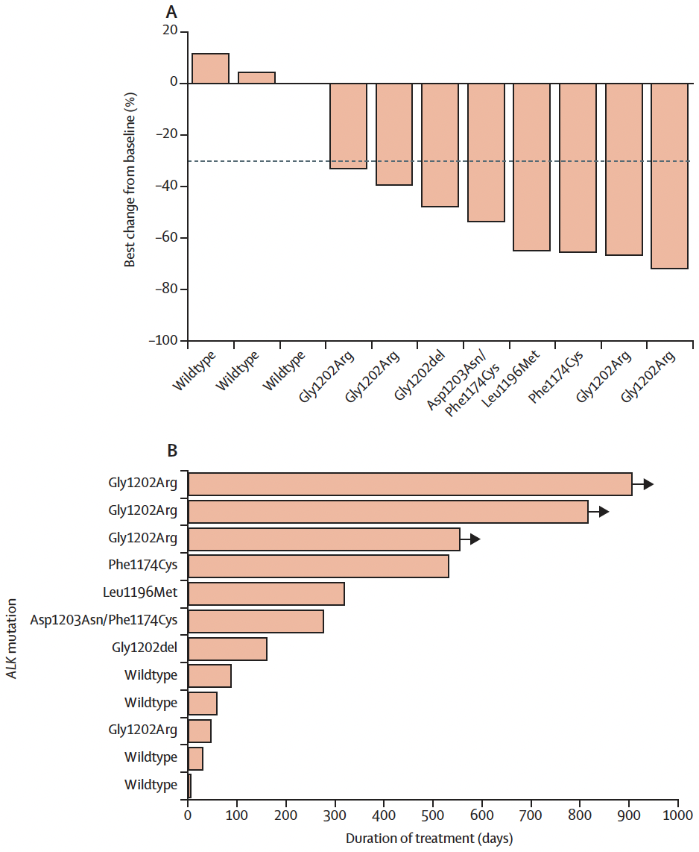
Evolution des séquences thérapeutiques – algorithme pour ALK
ORR, by molecular alterations
ALK dependant resistance mechanism at progression
Crizotinib
Ceritinib
Alectinib
Brigatinib
WT
WT
WT
WT
DOR, by molecular alterations
Gainor JF, Cancer Discov 2016, Epub October; Shaw A, Lancet Oncol 2017, Epub October

Slide 42
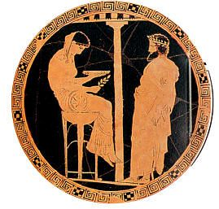
Evolution des séquences thérapeutiques – algorithme pour ALK
Option 2 sequence: rebiopsy and plasma ctDNAfor decision making at progression
Resistance
By plasma and tissue biopsy
ALK dependent mechanism: 25%
ALK
Non ALK dependent mechanism: 75%
If G1202R mutation:
Lorlatinib Or Trial
Beyond progression
Loco-regional treatment
If non G1202R mutation or ≥ 1 mutations:
Lorlatinib, brigatinib, ceritinib, crizotinib depending on ALKogram?
Or Trial
Alectinib
Treatment options
?
Brigatinib
If loss of ALK or no ALK mutation or Variant 1:
Pemetrexed platinum doublet ± bevacizumab
Or Trial
Lorlatinib?
IFCT 1902 ORAKLE

Slide 43
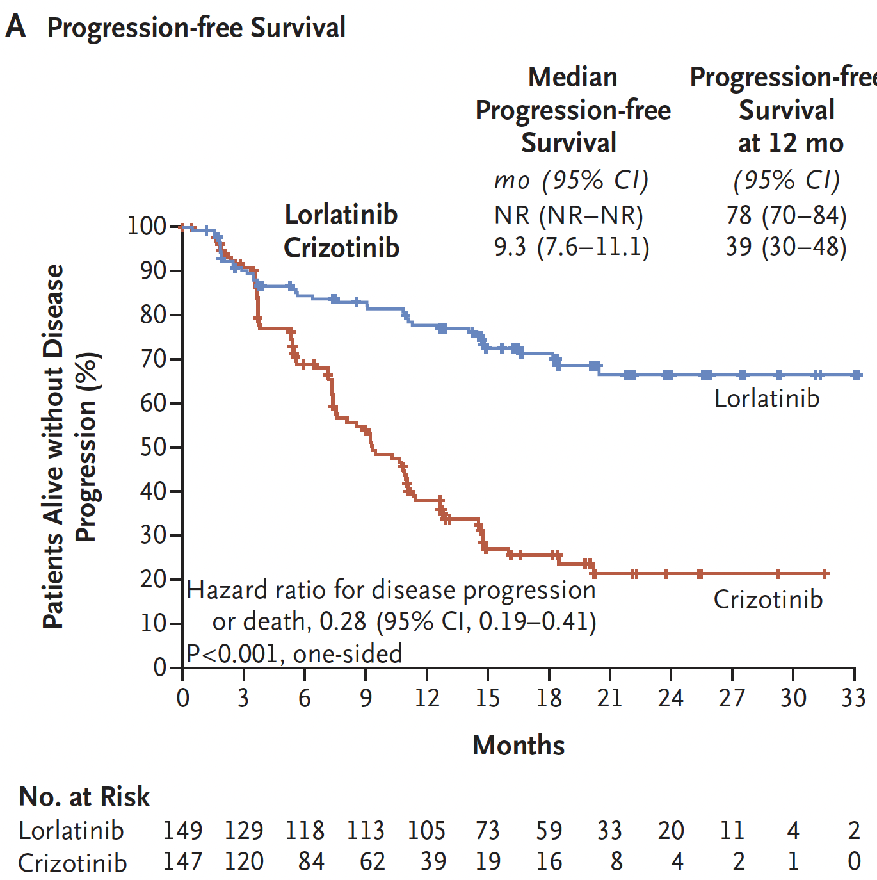
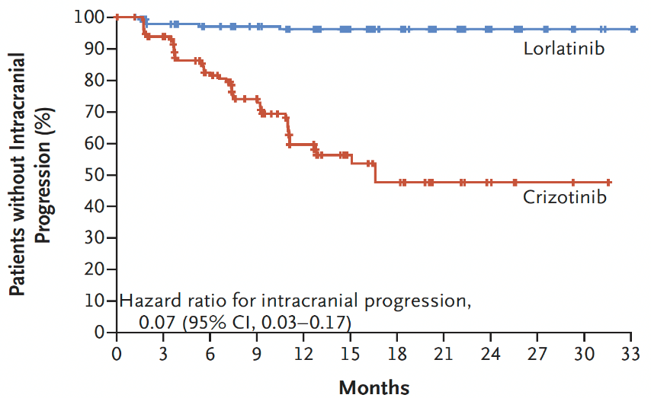
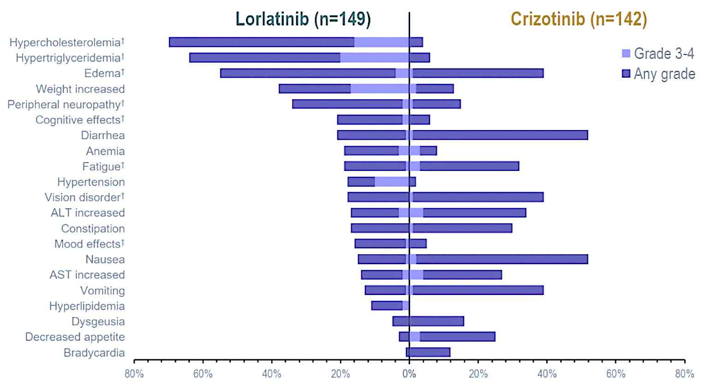
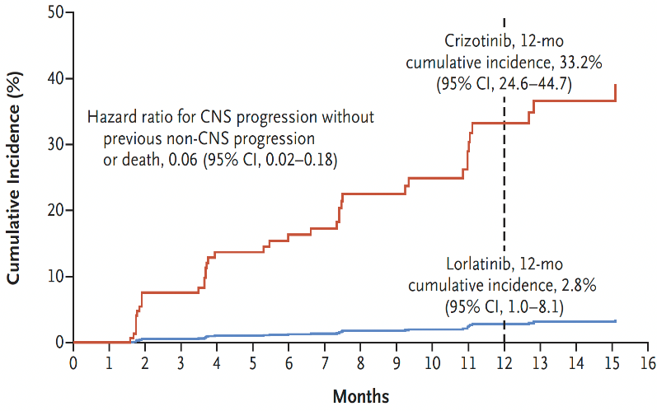
Evolution des séquences thérapeutiques – algorithme pour ALK
Crown Phase III 1st line treatment, lorlatinib vs crizotinib
Advanced NSCLC, ALK by IHC central testing, brain mets 26%, no cross-over authorized
Survival without CNS progression
All causality Aes with ≥10% difference in frequency
Better QoL
Cumulative incidence of CNS progression
Shaw T, N Engl J Med 2020, 383:2019

Slide 44
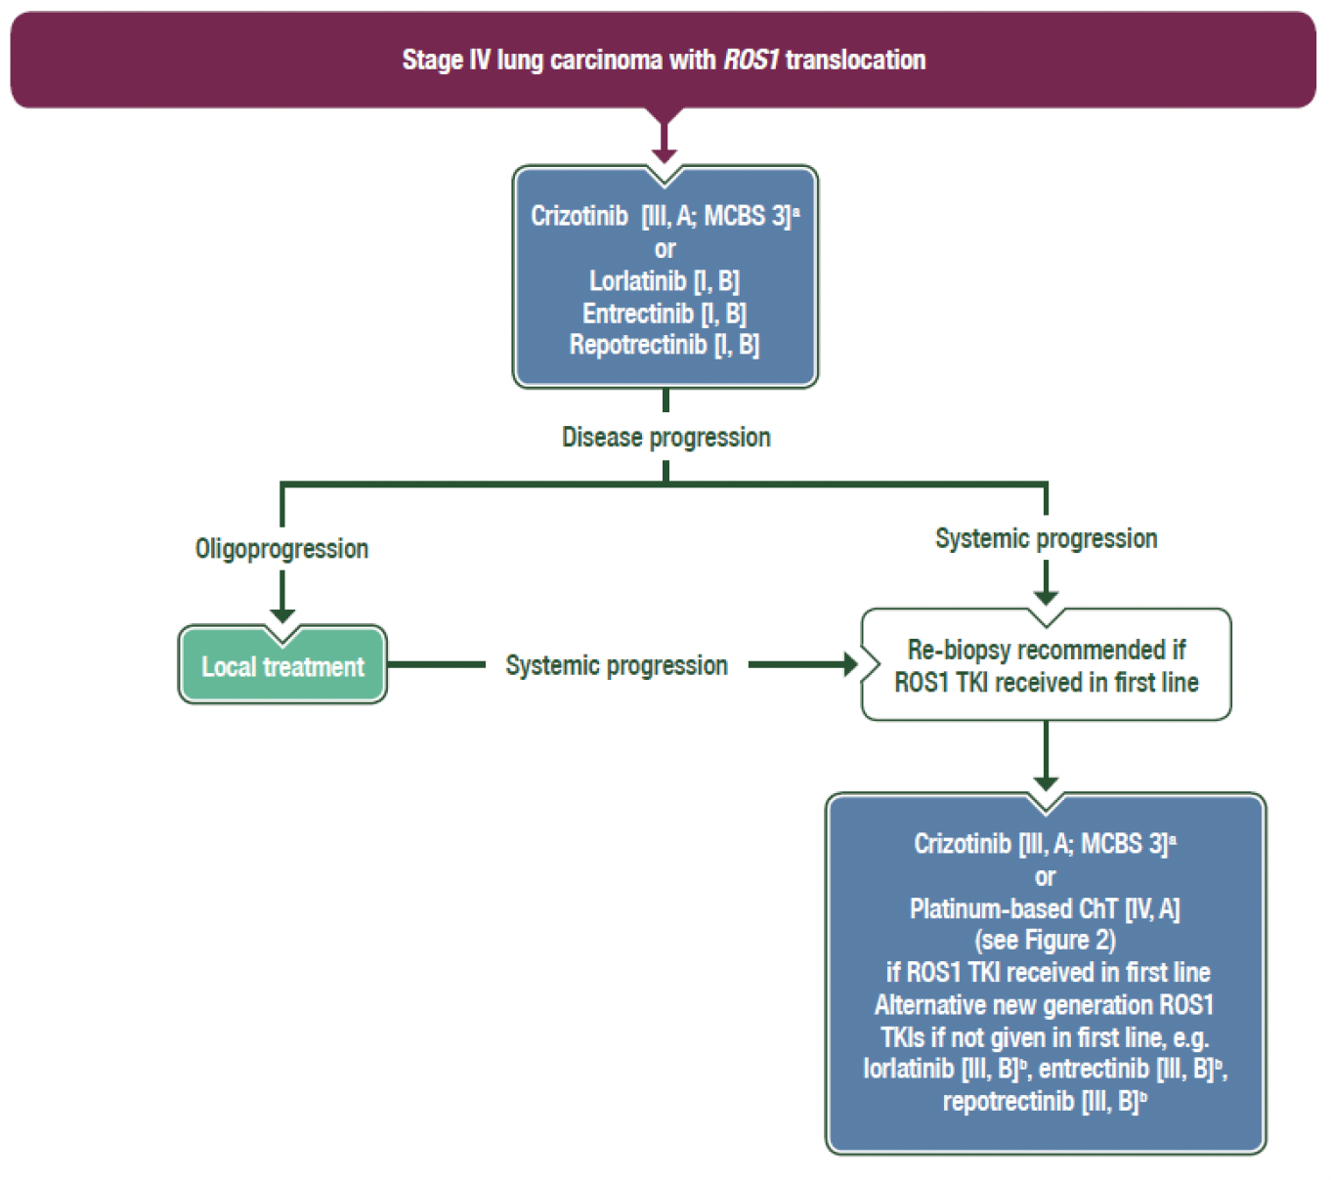
Evolution des séquences thérapeutiques – algorithme pour ROS
•
• Non approuvés par EMA
• ESMO Option
• Non remboursés en France
(ceritinib)
(brigatinib)
(cabozantinib)
•
AURA, NEON, NOCOBFC, ONCORIF, mais non remboursé
Planchard D, Clinical Practice Guidelines ESMO 2020
Notes:
There was however several limitations

Slide 45
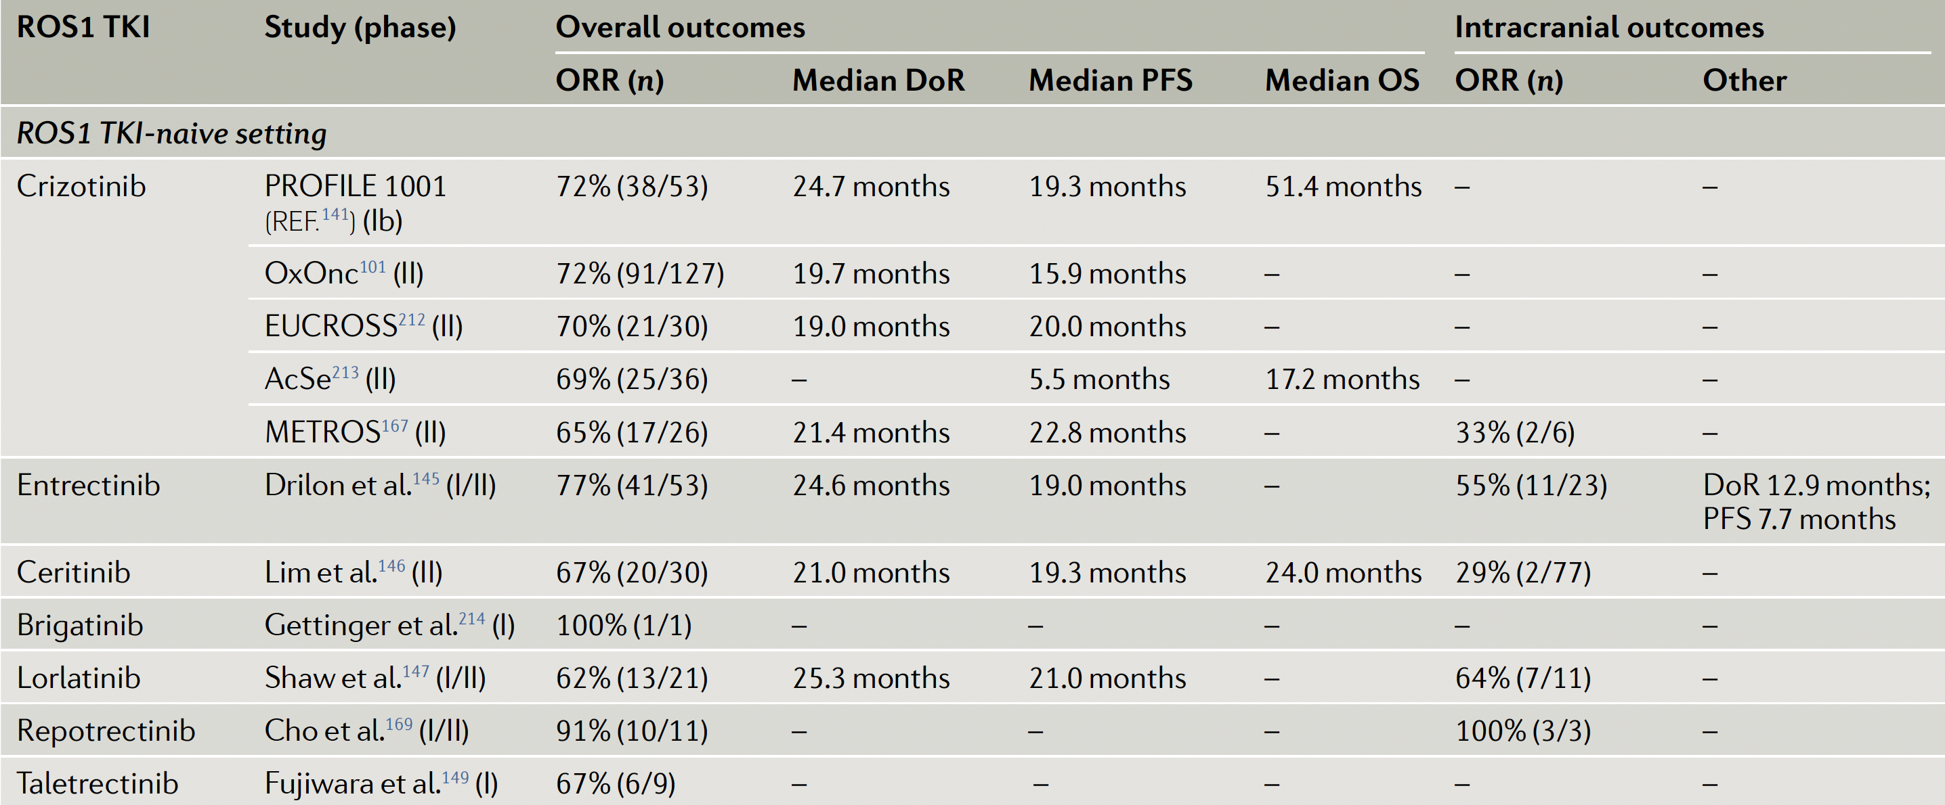
Evolution des séquences thérapeutiques – algorithme pour ROS
Le crizotinib est le standard de traitement de 1ère ligne des CBNPC ROS1
Drilon A, Nature Rev Clin Oncol 2021, 18:35

Slide 46
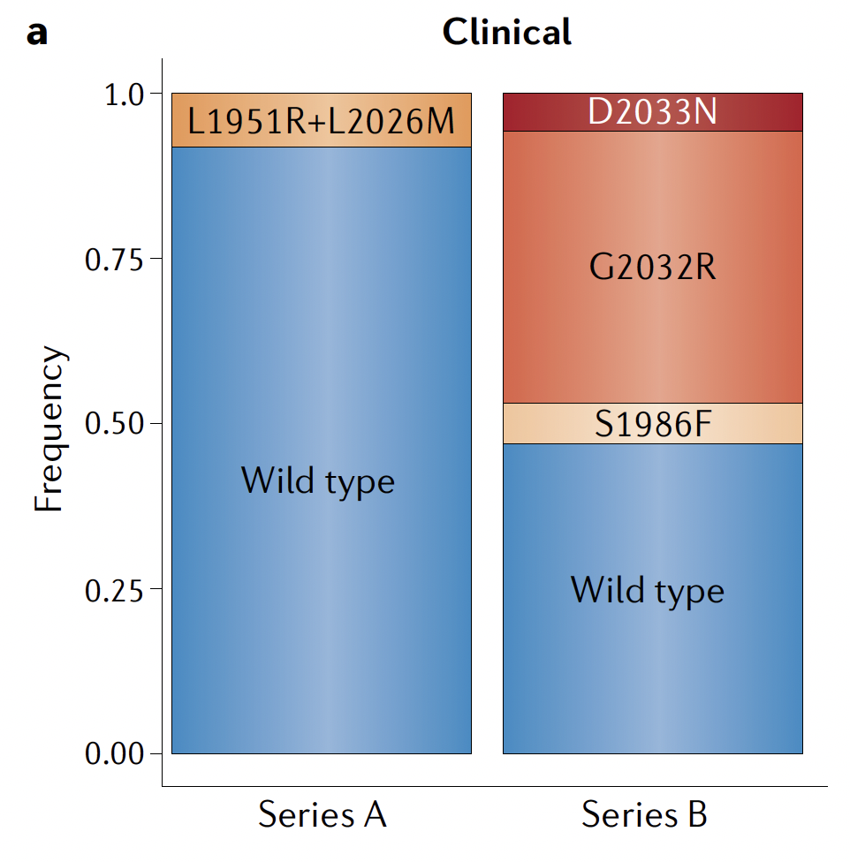
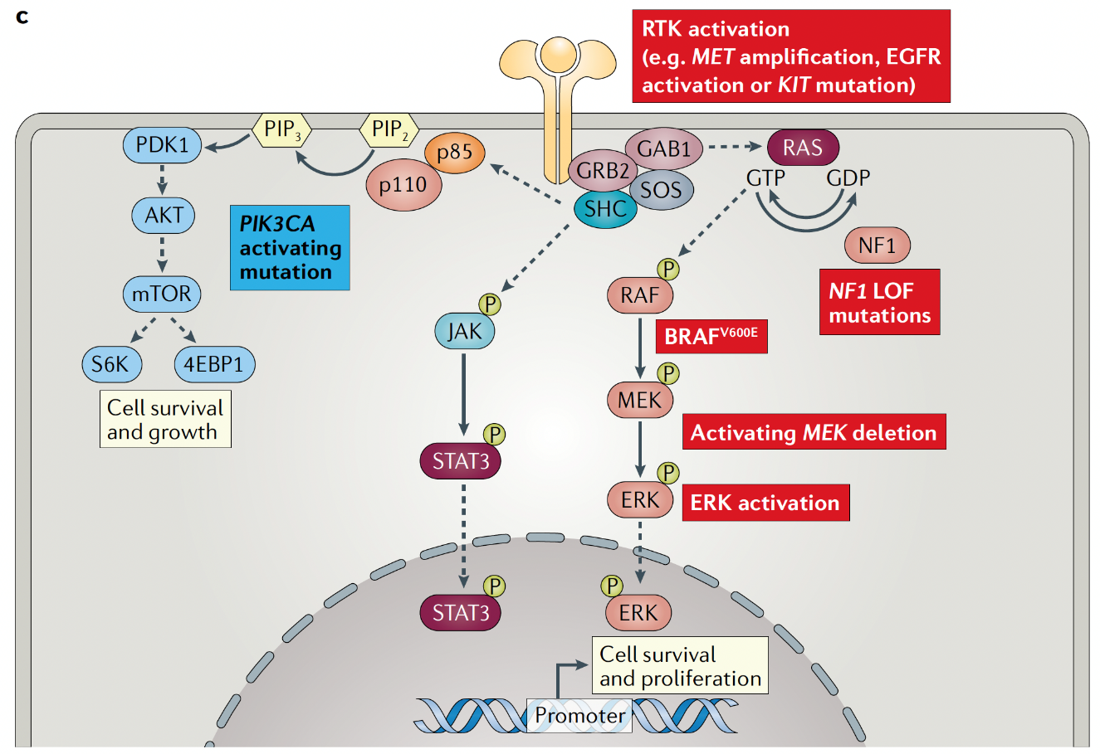
Evolution des séquences thérapeutiques – algorithme pour ROS
Intrasinc resistance mechanisms to crizotinib
Extrasinc resistance mechanisms to crizotinib
ROS1 multi-TKIs R
n=39
n=12
Drilon A, Nature Rev Clin Oncol 2021, 18:35; Gainor JF, JCO Prec Oncol 2017; Mc Coach C, Clin Cancer Res 2018, 24:3344;

Slide 47
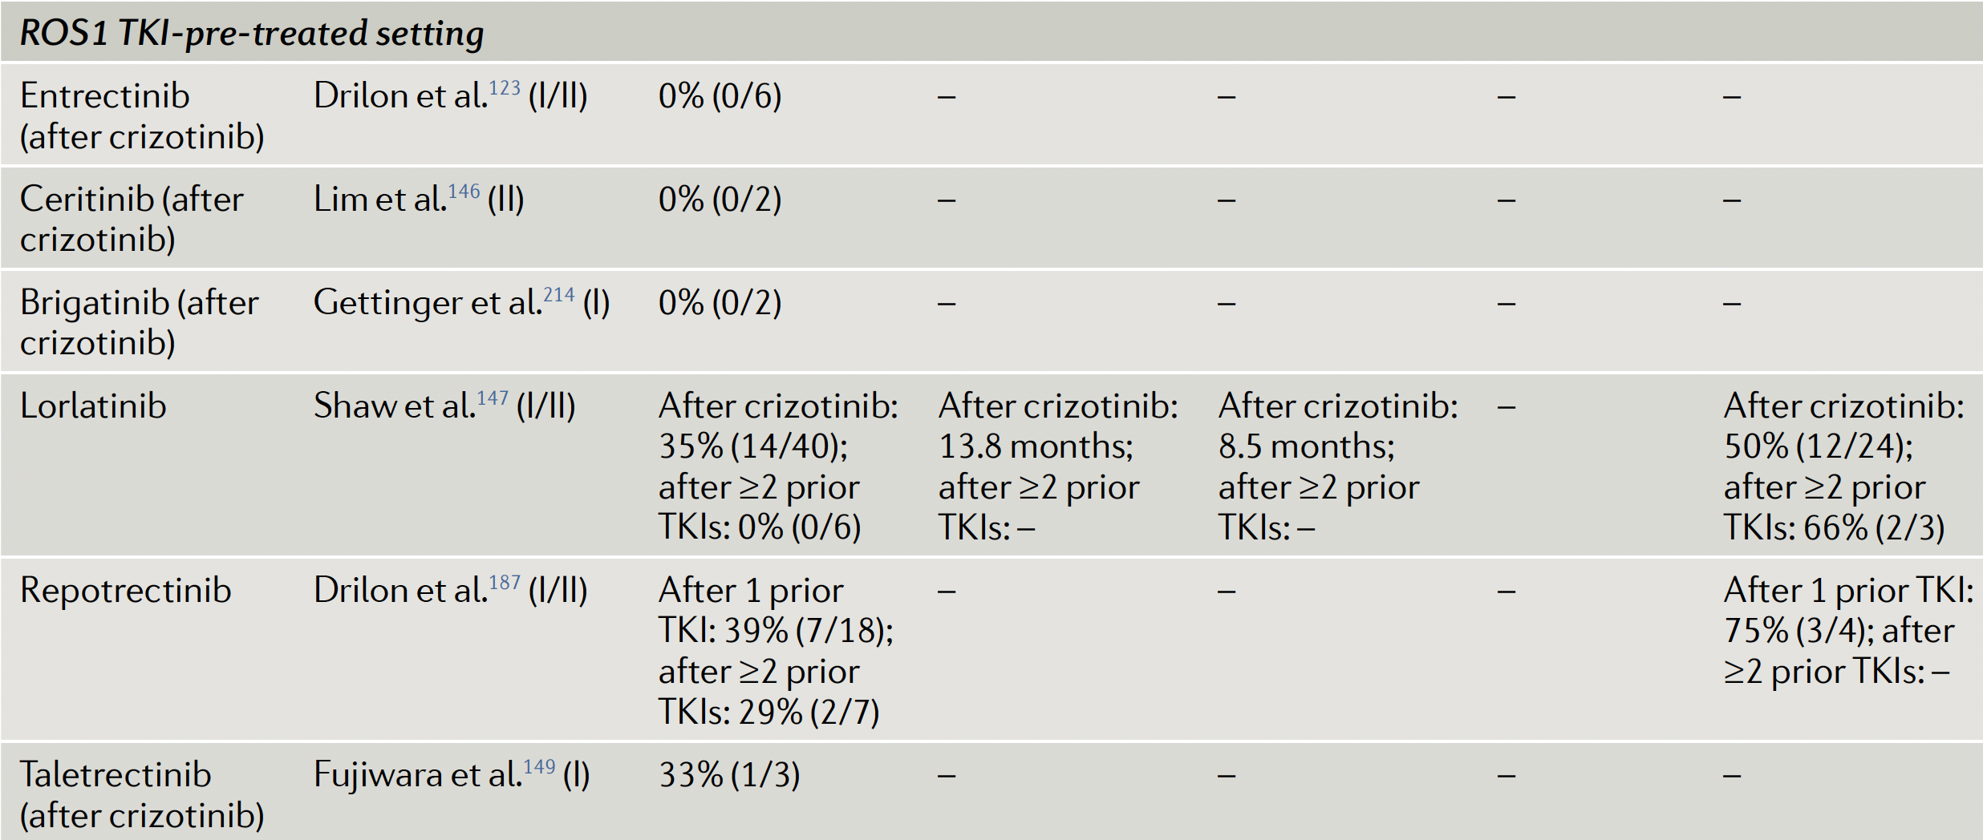
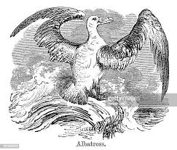
Evolution des séquences thérapeutiques – algorithme pour ROS
IFCT 2003 ALBATROS
Drilon A, Nature Rev Clin Oncol 2021, 18:35

Slide 48
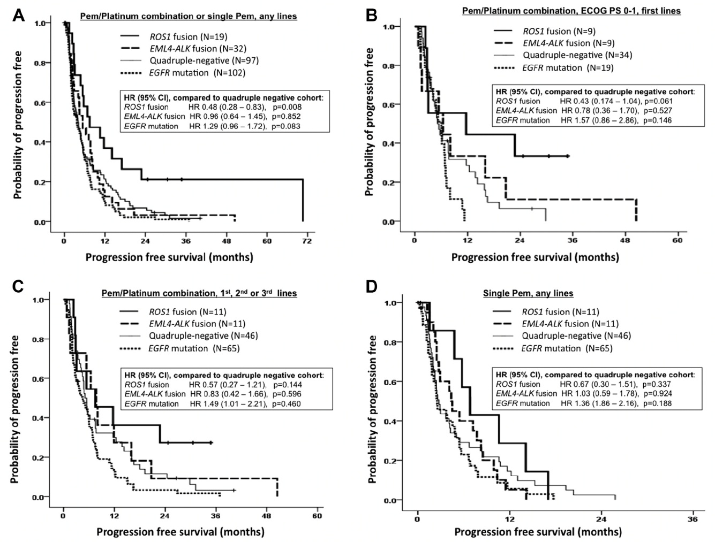
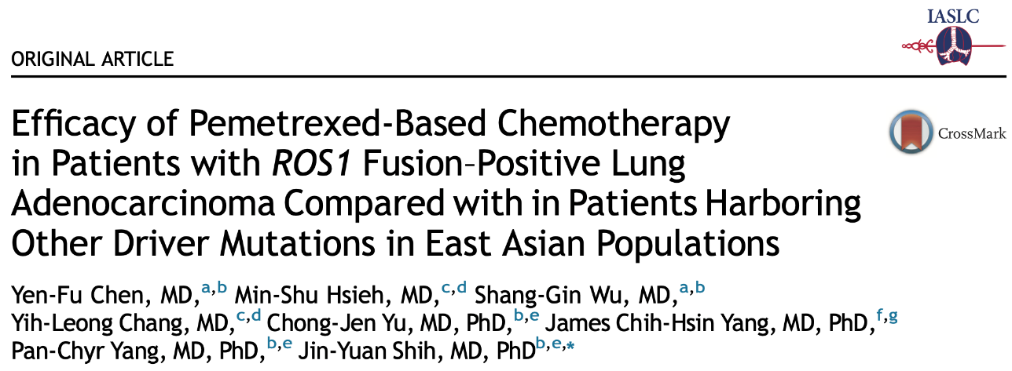
Evolution des séquences thérapeutiques – algorithme pour ROS
Retrospective cohort of oncogenic driven NSCLC treated by pemetrexed
ROS1
ROS1
ROS1
ROS1
Chen YF JTO 2016, 11:1144

Slide 49
EGFR, BRAF, ALK, ROS1 conclusions

Slide 50
EGFR, BRAF, ALK, ROS1 conclusions
THERAPIES CIBLEES
Médicament | Statut | Indication
Ensartinib (X-396) | AAC (ex ATU Nominative) | ALK en énième ligne
Capmatinib (Tabrecta®) | Passage en AAP (ex ATU de cohorte) | c-MET exon 14 après L1
Tepotinib (Tepmetko®) | AAC (ex ATU Nominative) | c-MET exon 14 après L1
Mobocertinib (TAK-788) | AAC (ex ATU Nominative) | EGFR exon 20 après L1
Poziotinib (NOV120101) | AAC (ex ATU Nominative) | EGFR exon 20 : à justifier à l’ANSM
Pralsetinib (Gavreto®) | AAP (ex ATU de cohorte) | Fusion RET+ après L1
Selpercatinib (Retsevmo®) | AAP post-AMM (ex Post-ATU) | Fusion RET+ après L1
Repotrectinib (TPX-0005) | AAC (ex ATU Nominative) | Pas d’indication définie, à priori destiné aux ROS1
Sotorasib (Lumakras®) | Passage enAAP (ex ATU de cohorte) | Mutation KRAS G12C après L1
Amivantamab | AAP (ex ATU de cohorte) | EGFR exon 20 après L1
Seribantumab (MM-121) | AAC (ex ATU Nominative) | Pas d’indication définie, fusion NRG1
Importance de l’évaluation moléculaire initiale et à progression
• Exposer le malade à la meilleure stratégie de 1ère ligne
• Anticiper la ligne suivante
• Anticiper l’inclusion dans un essai thérapeutique
• Anticiper la présentation à la RCP France Génomique
Importance d’exposer le malade à une thérapie ciblée
• Améliorer la survie globale
• Améliorer la QdV

Slide 51
Les CBNPC mutés EGFR
48 000
CB/an
Common (classic) mutation
Rare mutation
Complex mutation
Co-mutations
Biomarqueurs France
89%, exon 19/21
(n=1837)
>600 different EGFR mutations
Exon 21
38%
Exon 19
51%
Données INCa 2016; Leduc C, Ann Oncol 2017, 28:2715

