Slide 1
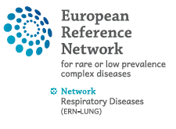
﻿Actualités dans l’Hypertension Pulmonaire Retour du 7th WSPH
SPIF
Paris 2024
Pr David MONTANI
Centre Coordonnateur du CRMR PulmoTension, Service de Pneumologie et Soins Intensifs Respiratoires Hôpital Bicêtre (APHP) – Université Paris-Saclay – INSERM UMR_S999 Le Kremlin-Bicêtre – France

Slide 2
Conflict of interest disclosure
Affiliation / Financial interest | Commercial company
Grants/research support: | Acceleron, Bayer, GSK, Janssen, MSD, Pfizer
Honoraria or consultation fees: | Acceleron, Bayer, Boerhinger, Chiesi, CSL Behring, GSK, Janssen, MSD, Pfizer
Participation in a company sponsored bureau: | None
Stock shareholder: | None
Spouse / partner: | None
Other support / potential conflict of interest: | None

Slide 3
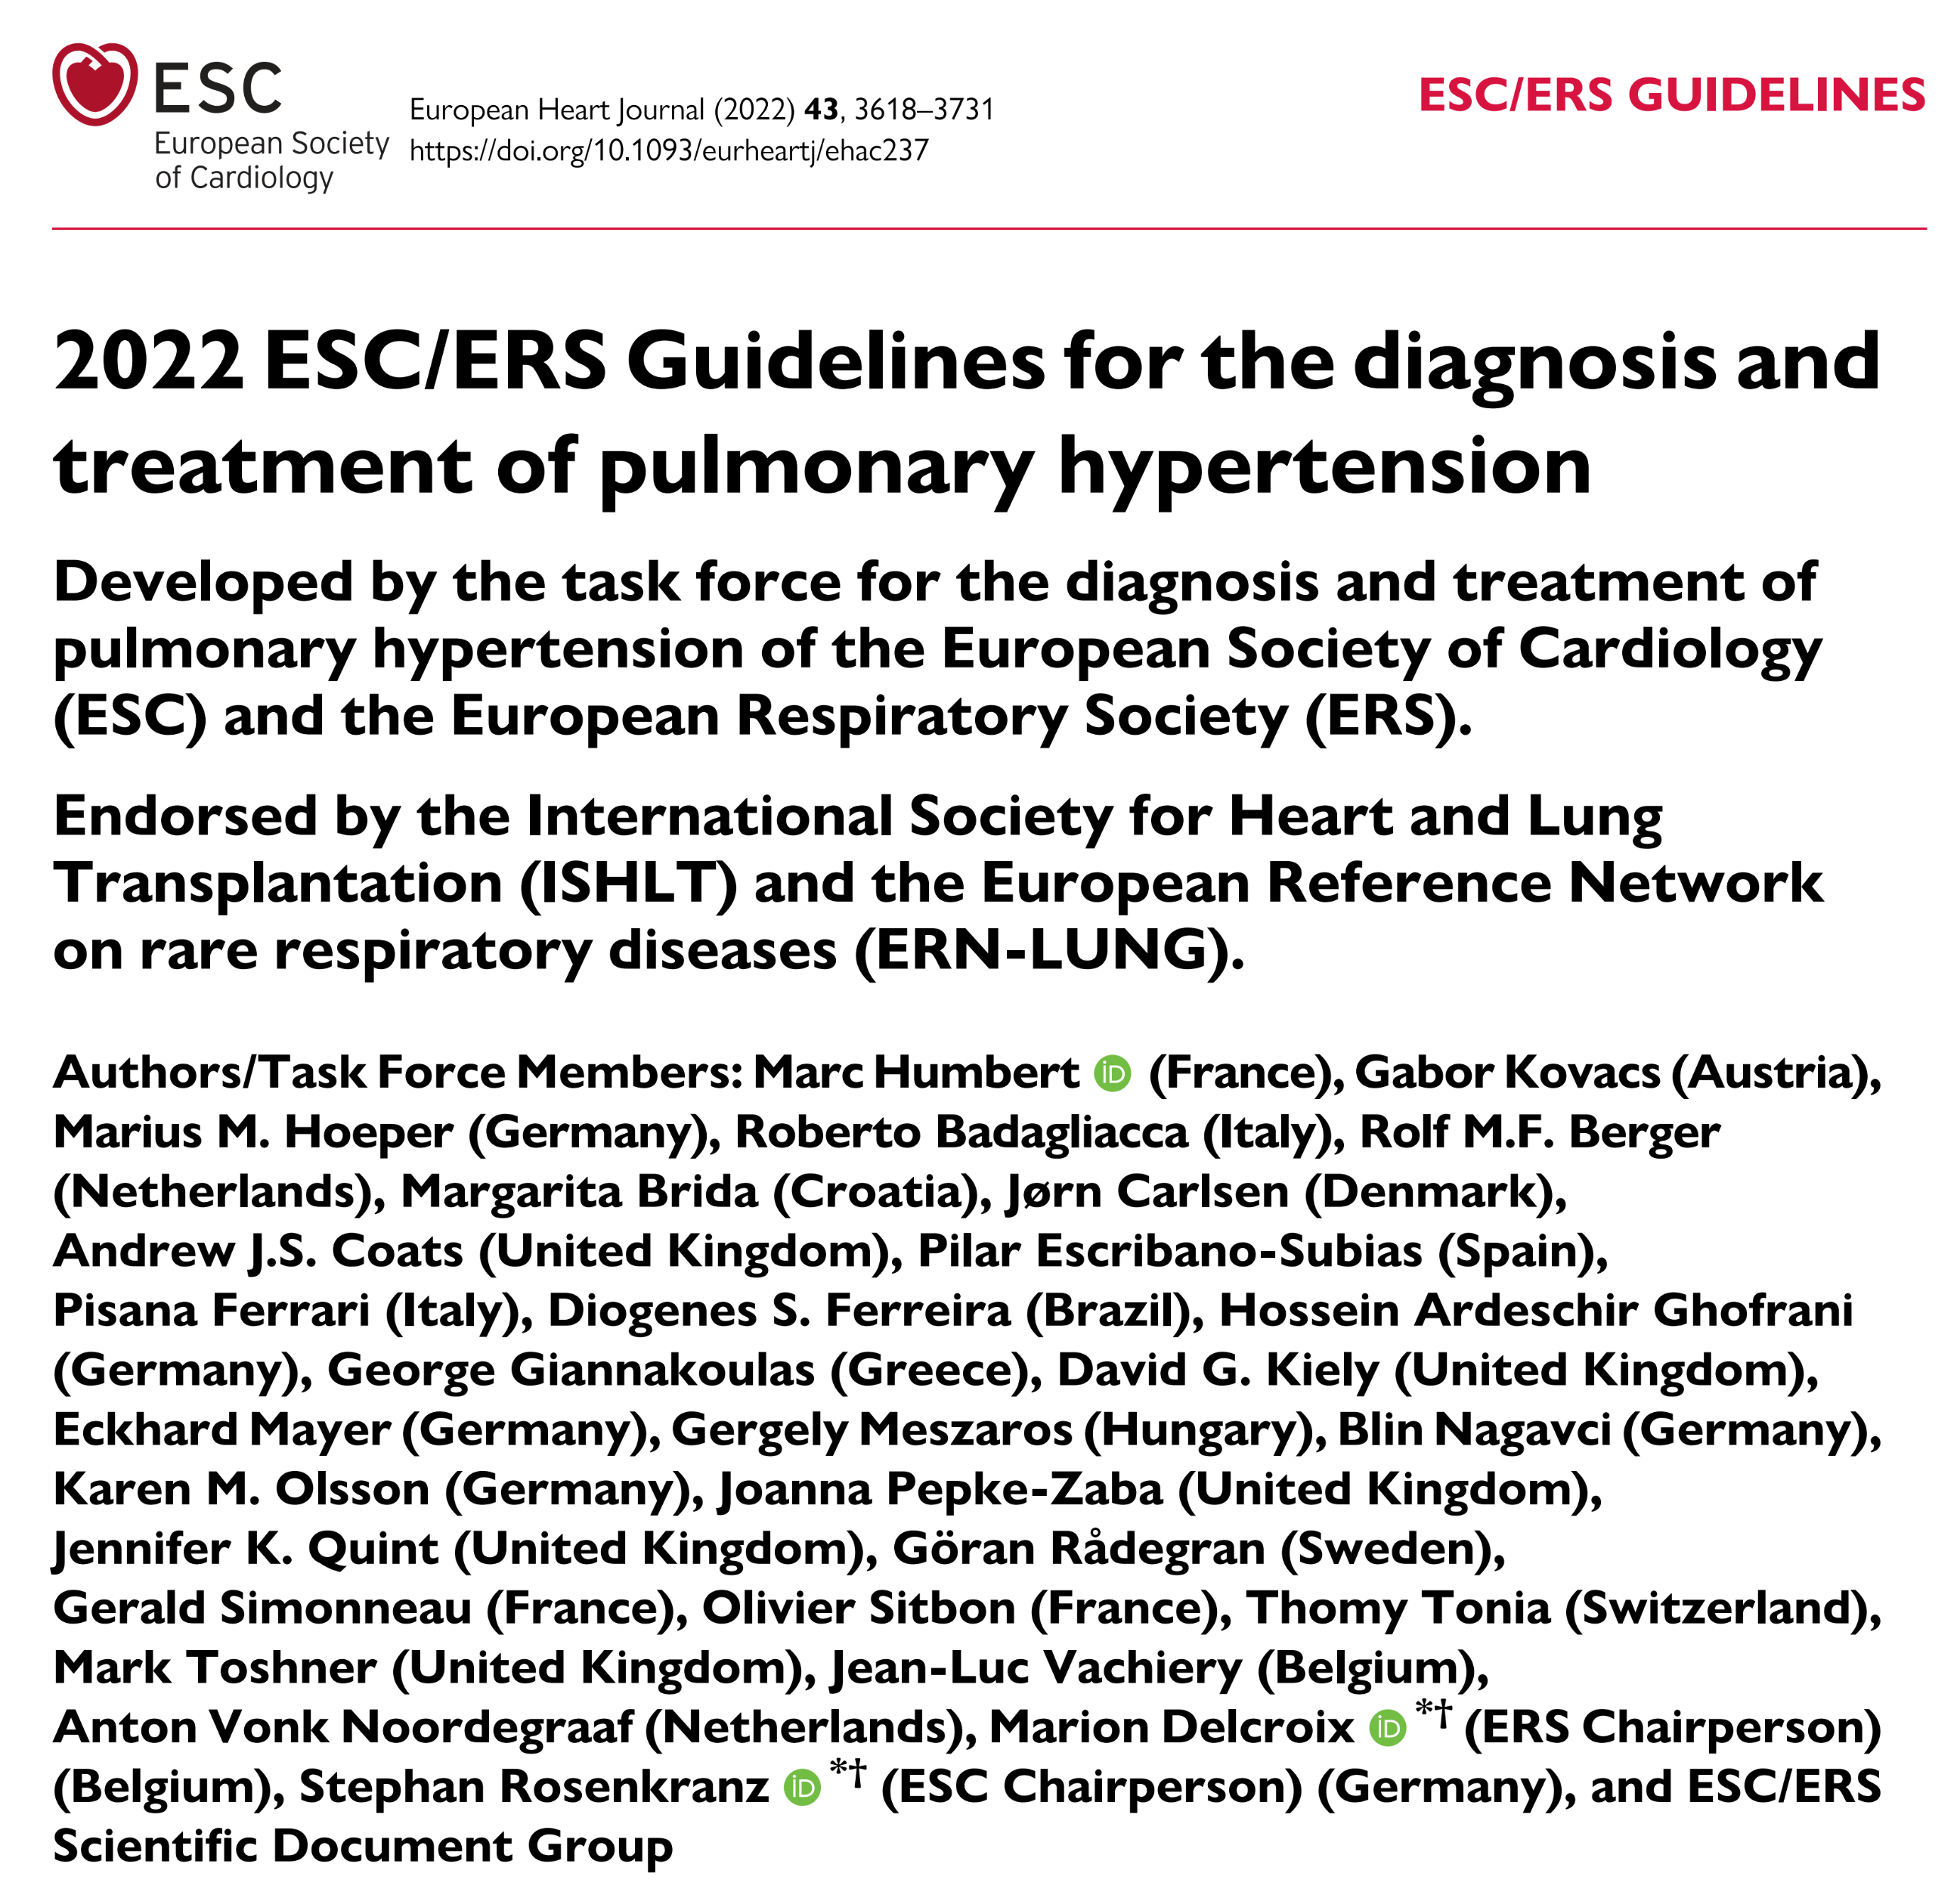
Guidelines 2022

Slide 4
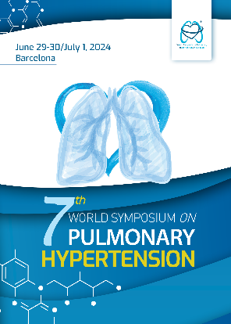
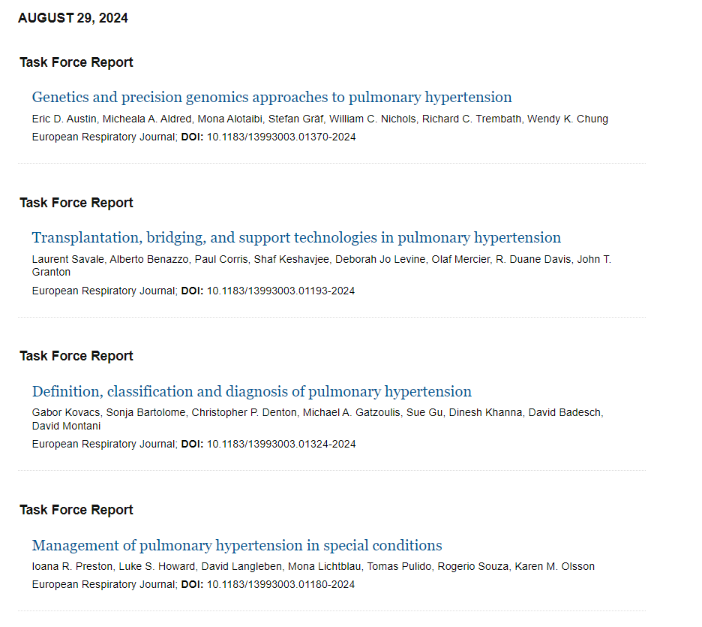
7th WSPH – Barcelona 2024
15 Articles = Proceedings of each taskfoce

Slide 5
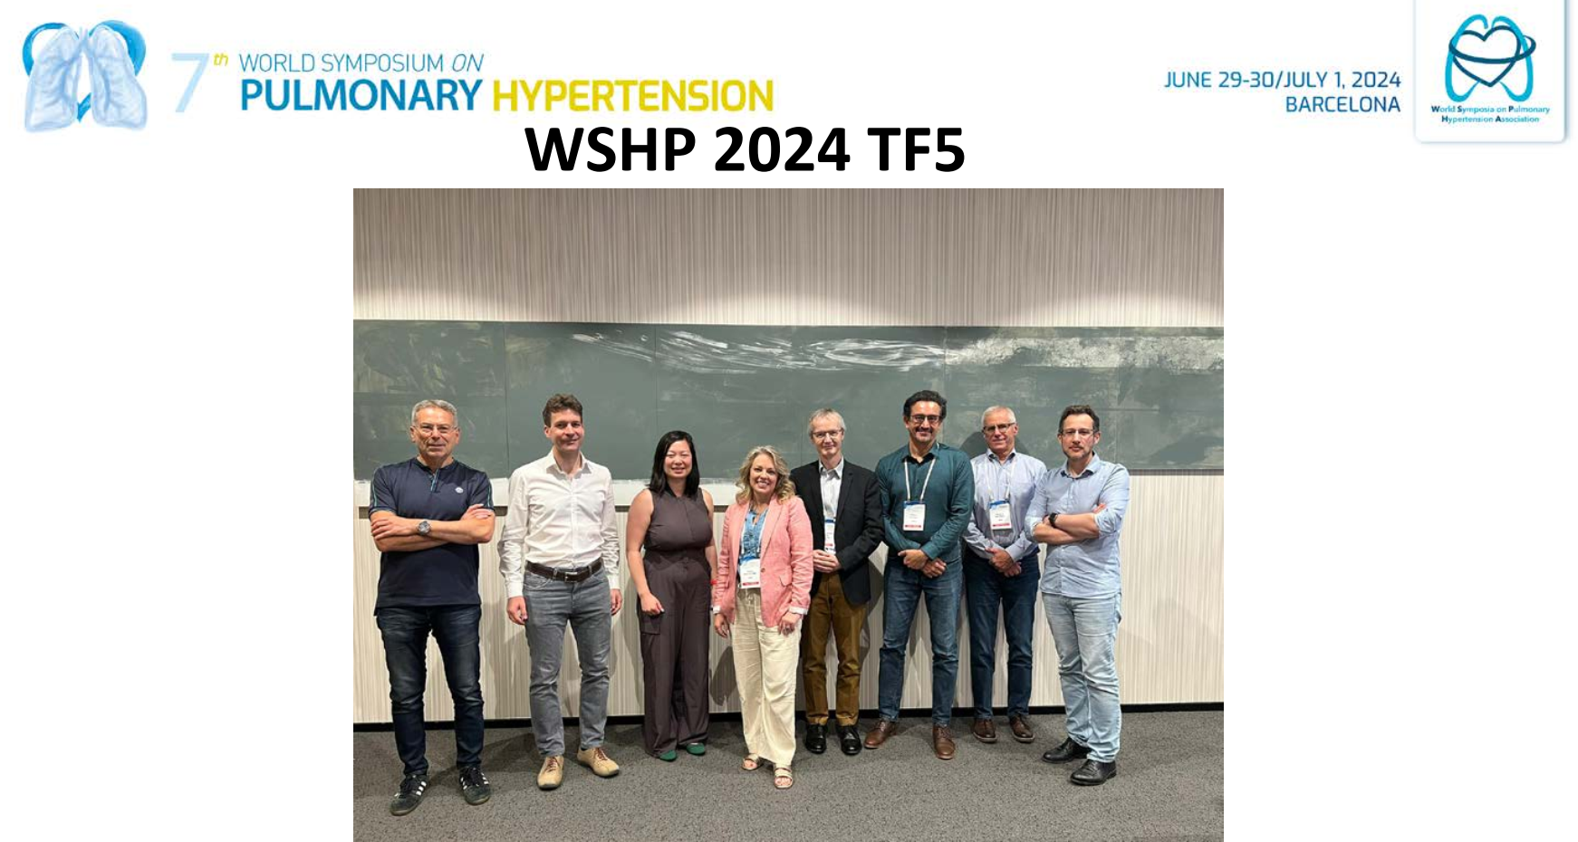

Slide 6
﻿Patient Perspectives

Slide 7
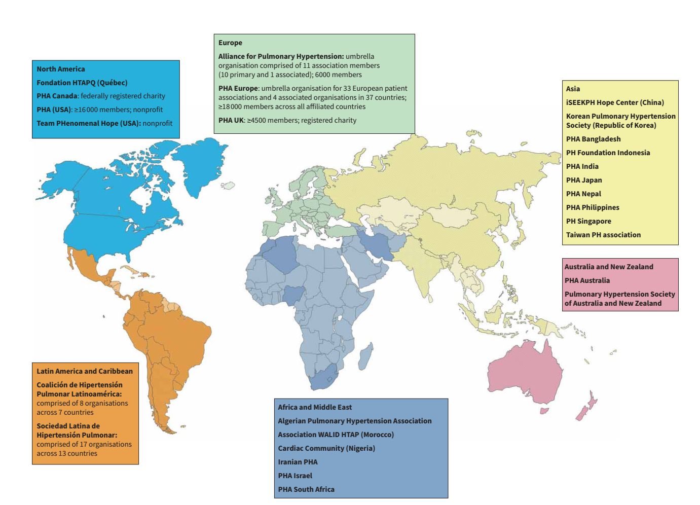
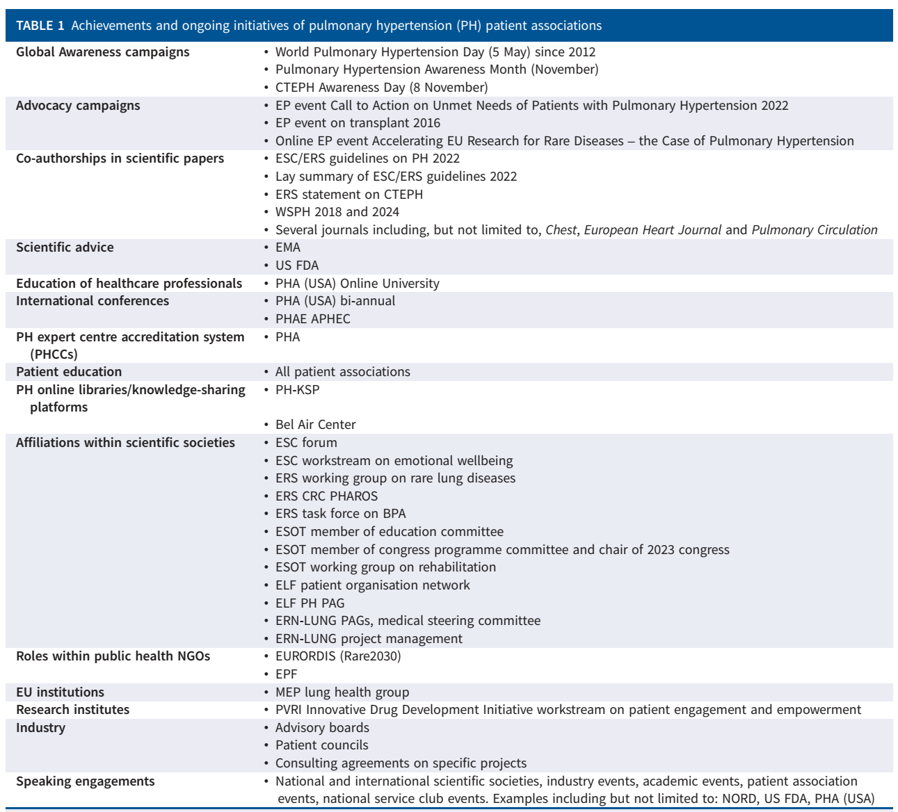
7th WSPH – Barcelona 2024

Slide 8
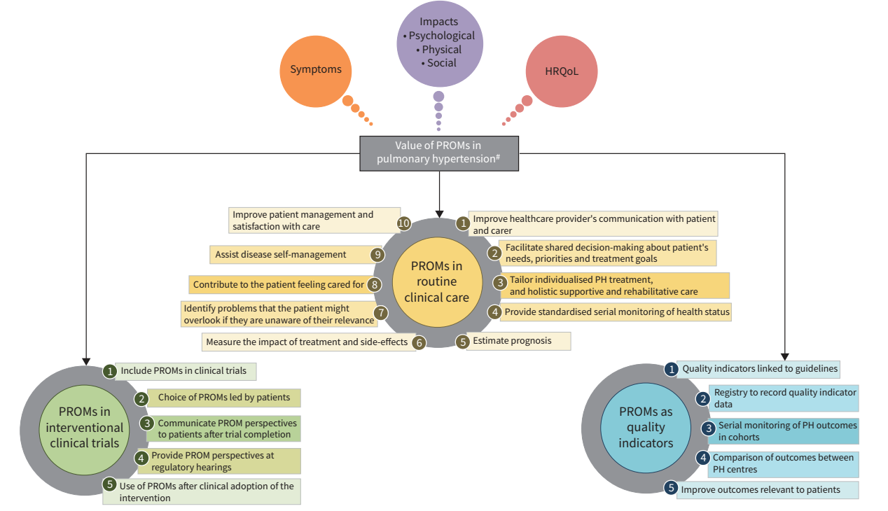
7th WSPH - Exploring the patient perspective in PH

Slide 9
﻿Definition

Slide 10
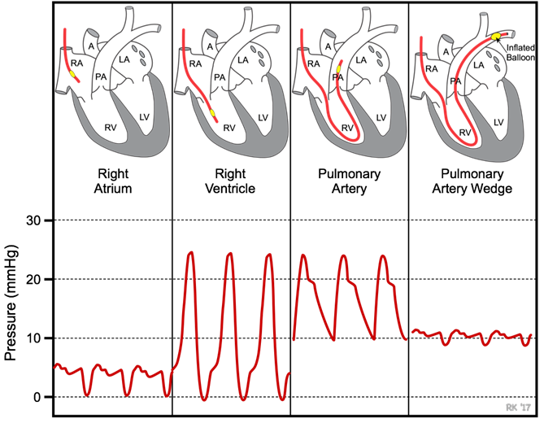
Definition of pulmonary hypertension
Guidelines 2022
Definition | Haemodynamic characteristics
PH | mPAP >20 mmHg
Pre-capillary PH | mPAP >20 mmHg PAWP ≤15 mmHg PVR >2 WU
Isolated post-capillary PH | mPAP >20 mmHg PAWP >15 mmHg PVR ≤2 WU
Combined post- and pre-capillary PH | mPAP >20 mmHg PAWP >15 mmHg PVR >2 WU
Exercise PH | mPAP/CO slope between rest and exercise >3 mmHg/L/min
RAP
RV
mPAP
PAWP
PVR = (mPAP – PAWP) / cardiac output
Humbert M et al. Eur Respir J 2022; in press: 2200879; Humbert M, et al. Eur Heart J 2022; 43: 3618-3731.

Slide 11
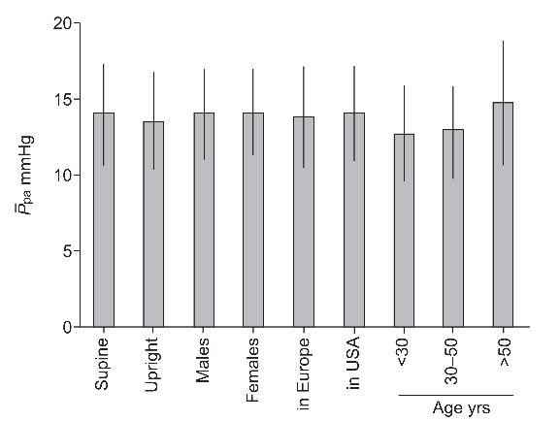
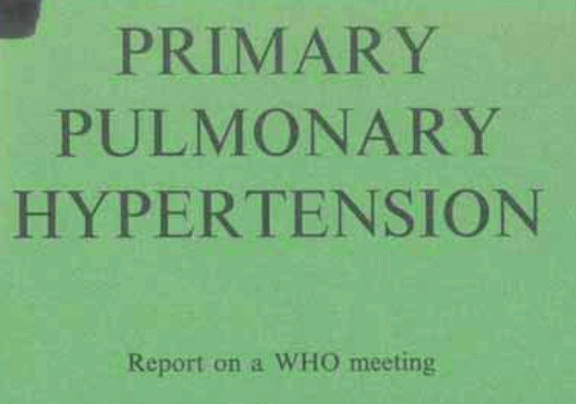
Definition of pulmonary hypertension
Guidelines 2022
Hemodynamics in 882 healthy subjects
Definition from the
1st world Symposium on PH (Evian, 1973)
25
3DS = 25 mmHg
2DS = 20 mmHg
2022
Kovacs G. et al. Eur Respir J 2012
Humbert, Eur Respir J 2022

Slide 12
Definition of pulmonary hypertension
Guidelines 2022
Definition | Haemodynamic characteristics
PH | mPAP >20 mmHg
Pre-capillary PH | mPAP >20 mmHg PAWP ≤15 mmHg PVR >2 WU
Isolated post-capillary PH | mPAP >20 mmHg PAWP >15 mmHg PVR ≤2 WU
Combined post- and pre-capillary PH | mPAP >20 mmHg PAWP >15 mmHg PVR >2 WU
Exercise PH | mPAP/CO slope between rest and exercise >3 mmHg/L/min
RAP
RV
mPAP
PAWP
PVR = (mPAP – PAWP) / cardiac output
Humbert M et al. Eur Respir J 2022; in press: 2200879; Humbert M, et al. Eur Heart J 2022; 43: 3618-3731.

Slide 13
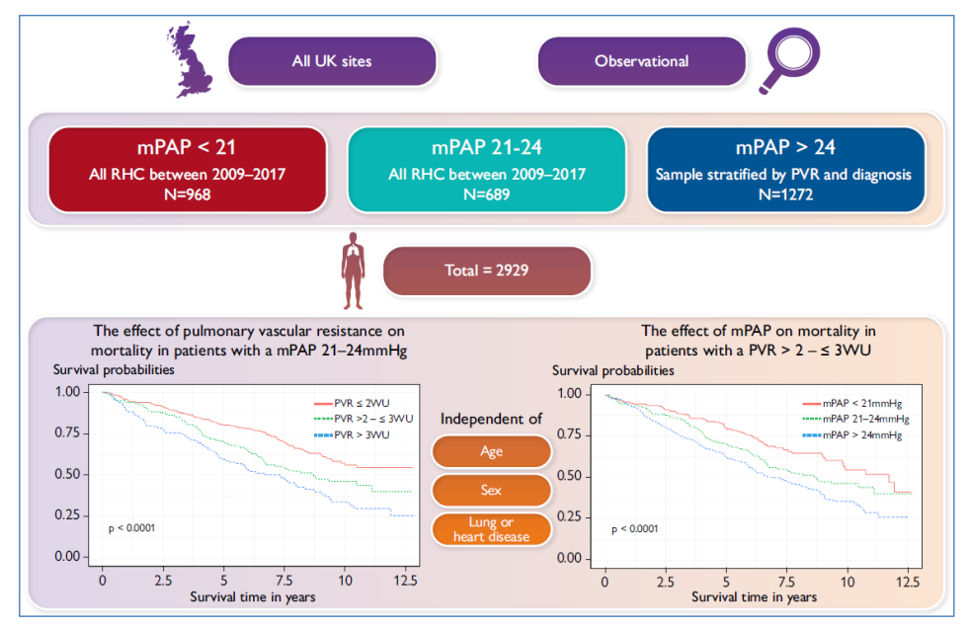
PVR threshold

Slide 14
PAWP threshold

Slide 16
Exercise PH

Slide 17
﻿Classification of PH

Slide 18
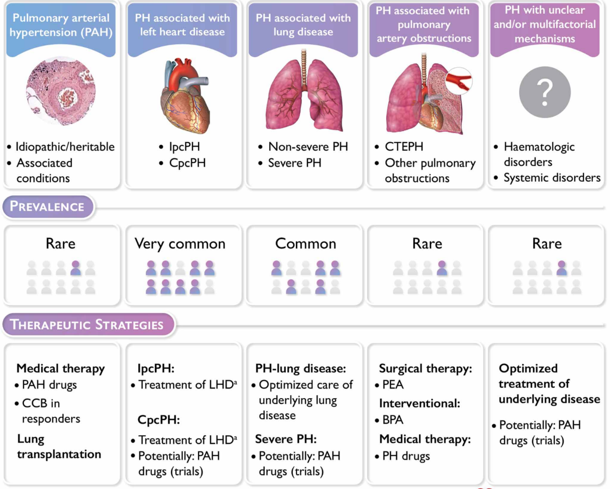
Clinical classification of pulmonary hypertension
2022
1
2
3
4
5

Slide 19
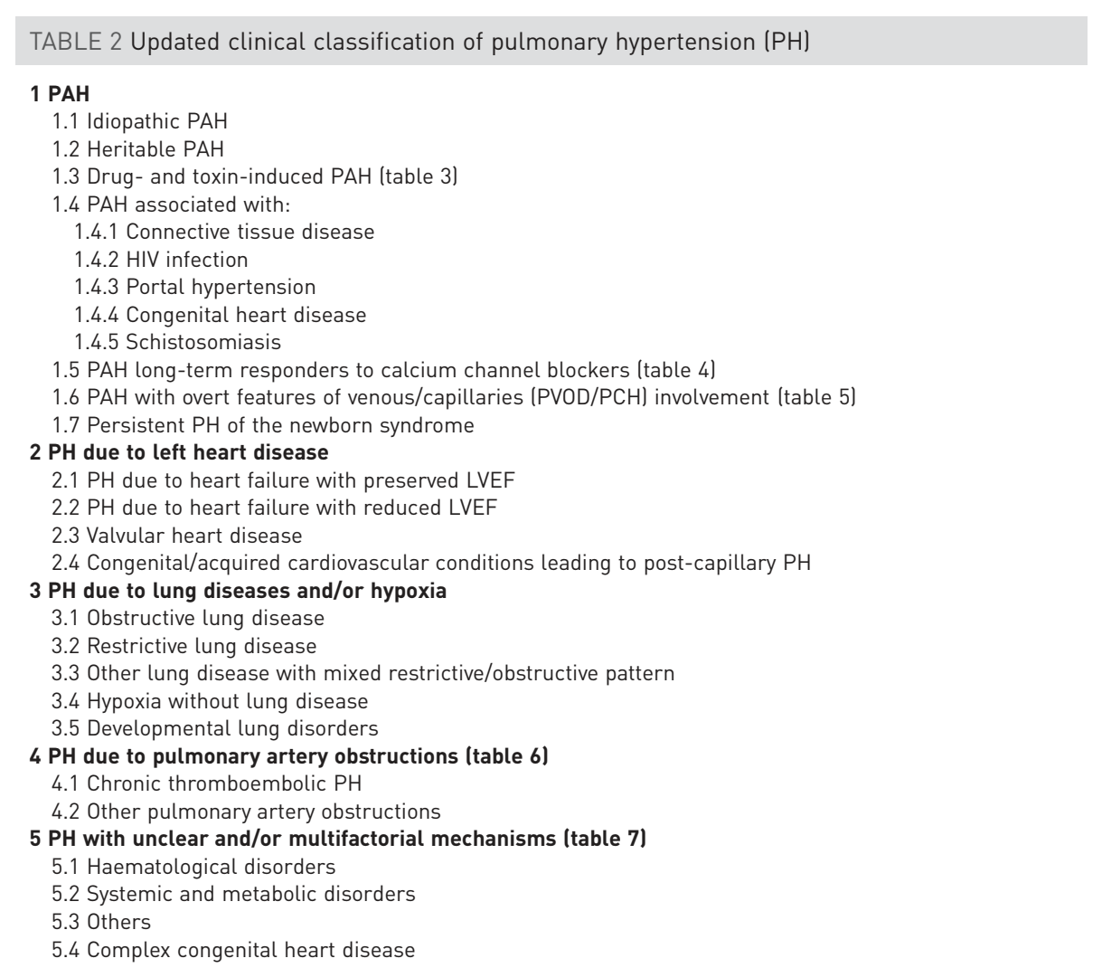
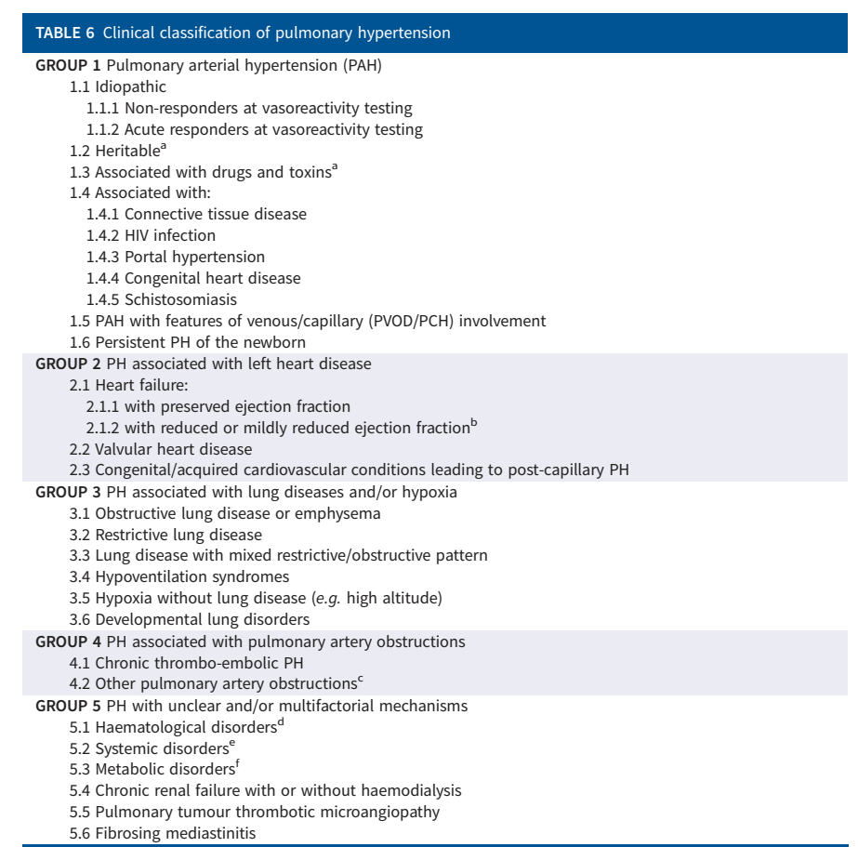
Updated clinical classification of Pulmonary hypertension
6th WSPH (2018)
2022 ESC/ERS guidelines

Slide 20
Updated clinical classification of Pulmonary hypertension
Should we keep the same structure for the classification ?
The general purpose of the clinical classification of PH is to categorize clinical conditions associated with PH according to similar pathophysiological mechanisms, clinical presentation, hemodynamic characteristics, and therapeutic management.
The 6th World Symposium on PH in 2018 and the 2022 ESC/ERS guidelines offer a comprehensive simplified version of the classification for both children and adults, divided into five subgroups.
To date, there is an absence of sufficient robust data to propose a classification based on pathophysiology or mechanisms that could guide management.
We suggest retaining the core structure of the clinical classification of PH; however, some clarifications and adjustments might be needed.

Slide 21
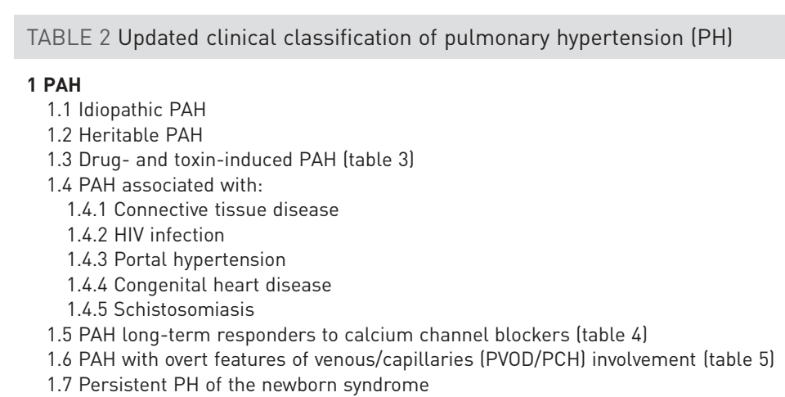
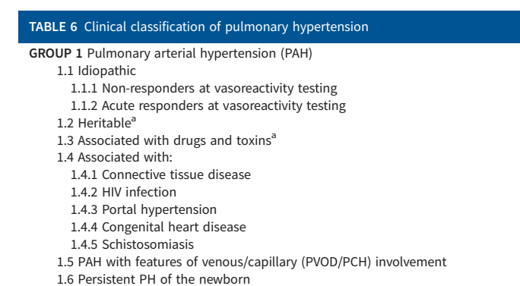
Updated clinical classification : Group 1 PAH
Acute/Long-term Responders
6th WSPH (2018)
2022 ESC/ERS guidelines
Simonneau, Eur Respir J 2019; Humbert, Eur Respir J 2023

Slide 22
Updated clinical classification : Group 1 PH
Inclusion of acute vasodilatory or long-term CCB response in the classification has some limitations.
Acute responders at vasodilatory testing:
A positive acute response to vasoreactivity testing predicts a potential long-term response
to calcium channel blockers = helpful to define management
Not all patients with an acute response demonstrate sustained clinical and hemodynamic
improvement on CCBs alone
Define a management rather than a specific phenotype
Long-term responders to calcium channel blockers:
Specific entity with a significantly better prognosis, unique management, and different
pathophysiology
Classification may change over time
Patients could only be included in this subgroup after long-term follow-up
+
-
-
+
-
-

Slide 23
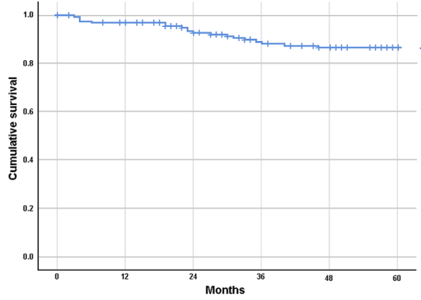
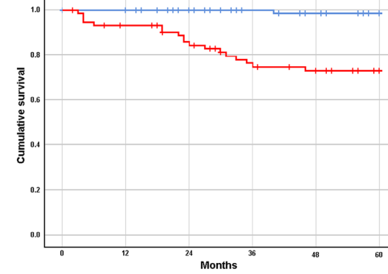
Group 1 Pulmonary Arterial Hypertension
All vasoresponders (n=162)
Long-term response to CCB n=88)
no long-term response (n=74)
Gerhardt , Circulation 2024

Slide 24
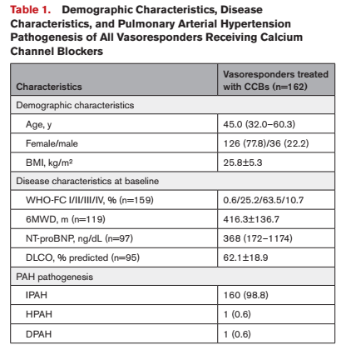
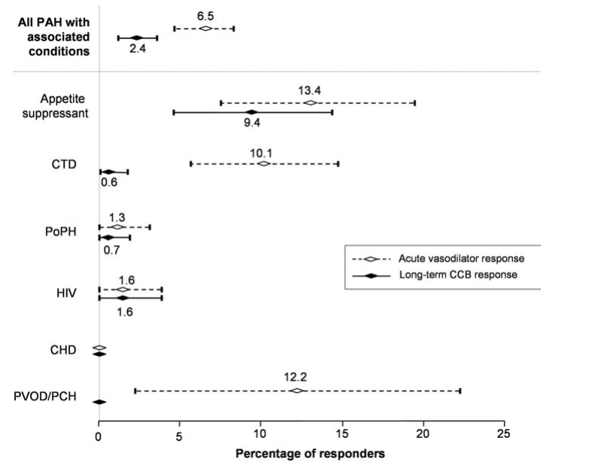
Group 1 Pulmonary Arterial Hypertension
n=1326 patients
12/127
(9.4%)
Gerhardt , Circulation 2024
Montani, Eur Heart J 2010

Slide 25
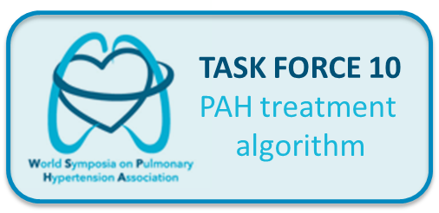
Group 1 Pulmonary Arterial Hypertension
GROUP 1 Pulmonary arterial hypertension (PAH)
1.1 Idiopathic
1.1.1 Long-term responders to calcium channel blockers
1.2 Heritable ª
1.3 Associated with drugs and toxins ª
1.4 Associated with:
1.4.1 Connective tissue disease
1.4.2 HIV infection
1.4.3 Portal hypertension
1.4.4 Congenital heart disease
1.4.5 Schistosomiasis
1.5 PAH with features of venous/capillary (PVOD/PCH) involvement
1.6 Persistent PH of the newborn
ª Rare patients with heritable PAH or PAH associated with drugs and toxins might be long-term responders to calcium channel blockers

Slide 26
Group 1 Pulmonary Arterial Hypertension
Drugs and Toxins associated Pulmonary arterial hypertension
The classification has evolved from three classes (definite, likely, possible) to two classes (definite and possible) since the 6th WSPH (2018).
However, these criteria do not take into account the diversity of evidence and criteria that have been explored to assess a causal link between a drug and PAH:
the duration of exposure before PAH diagnosis varies from a few weeks to several years depending on the drug,
regression of the disease after drug withdrawal observed for some but not all drugs,
PAH has been reproduced for only a few drugs in pre-clinical models
pharmaco-epidemiological and pharmacovigilance studies have generated various estimates of associations between drugs and PAH

Slide 27
Group 1 Pulmonary Arterial Hypertension
Drugs and Toxins associated Pulmonary arterial hypertension
We proposed an updated classification of drug-associated PAH based on previous definitions:
“Definite association” includes drugs with data based on outbreaks, epidemiological or pharmacovigilance studies, or large multicenter series.
“Possible association” is suggested by multiple case series or cases with drugs having similar mechanisms of action.
Additionally, we have considered that other factors should be taken into account, particularly for drugs with a possible association with PAH.
reversibility of PH after withdrawal of the drugs
existence of preclinical experimental data
histopathological findings typical of PAH
common mechanisms with drugs that have a definite association with PAH

Slide 28
Group 1 Pulmonary Arterial Hypertension
Drugs with definite association
Drugs | Case-reports or case series | Epidemiological or pharmacovigilance studies | Reversibility after drug withdrawal | Pre-clinical experimental data | Pathological findings typical of PAH | Categorization | References
Aminorex | X | X |  | X | X | Definite | [1–8]
Benfluorex | X | X |  |  | X | Definite | [9–12]
Dasatinib | X | X | X | X | X | Definite | [13–21]
Dexfenfluramine / Fenfluramine | X | X |  | X | X | Definite | [7, 8, 22]
Methamphetamines | X | X |  | X | X | Definite | [23–29]
Toxic rapeseed oil | X | X |  |  |  | Definite | [30–36]
Mitomycin C ª | X | X |  | X | X | Definite | [37–43]
Carfilzomib | X | X | X | X |  | Definite | [44–53]

Slide 29
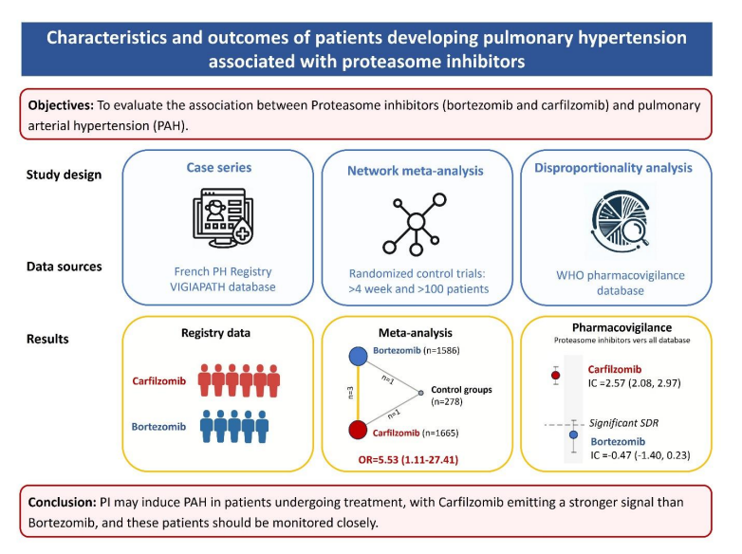
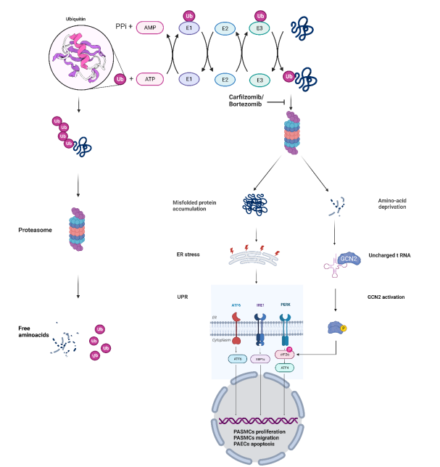
Group 1 Pulmonary Arterial Hypertension
Carfilzomib (proteasome inhibitor) associated PAH
Grynblat, Eur Respir J 2024; Budhram, Eur Respir J 2024

Slide 30
Group 1 Pulmonary Arterial Hypertension
Drugs with possible association
Drugs | Case-reports or case series | Epidemiological or pharmacovigilance studies | Reversibility after drug withdrawal | Pre-clinical experimental data | Pathological findings typical of PAH | common mechanisms with drugs /definite association with PAH | Categorization | References
Alkylating agents ª | X |  |  | X | X | X | Possible | [56–58]
Amphetamines | X |  |  |  |  | X | Possible | [30, 59, 60]
Bosutinib | X |  | X |  |  | X | Possible | [15, 17, 61–65]
Cocaine | X |  |  |  |  | X | Possible | [22, 66–69]
Diazoxide | X |  | X | X |  |  | Possible | [55, 70–77]
DAAs against HCV | X |  |  |  |  |  | Possible | [78, 79]
Indigo naturalis | X |  |  |  |  |  | Possible | [80–86]
Interferon α and β | X |  | X | X | X |  | Possible | [87–96]
Leflunomide | X |  |  |  |  |  | Possible | [97–101]
L-tryptophan | X |  |  |  |  |  | Possible | [102–104]
Phenylpropanolamine | X |  |  |  |  | X | Possible | [23]
Ponatinib | X |  |  | X |  | X | Possible | [62, 105, 106]
Solvents ª | X |  |  | X |  |  | Possible | [107–110]
St. John’s wort | X |  |  |  |  |  | Possible | [23]
Bevacizumab | X |  |  | X |  |  | Possible | [111–113]
Bortezomib | X | X |  |  |  | X | Possible | [46, 114]

Slide 31
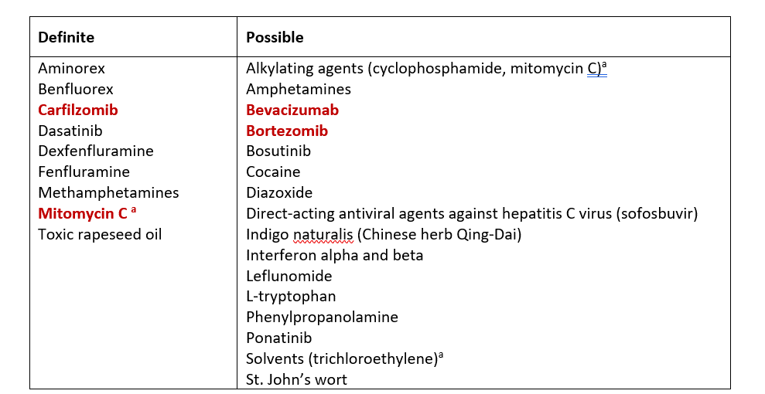
Group 1 Pulmonary Arterial Hypertension
Updated list of Drugs and toxins associated with PAH

Slide 32
Group 2 Pulmonary Hypertension
6th WSPH (2018)
2022 ESC/ERS guidelines
Simonneau, Eur Respir J 2019; Humbert, Eur Respir J 2023

Slide 33
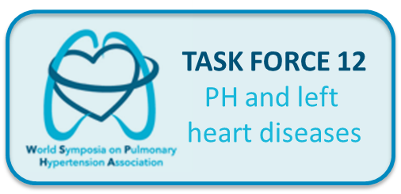
Group 2 Pulmonary Hypertension
2. PH associated with left heart disease
2.1 Heart failure:
2.1.1 with preserved ejection fraction
2.1.2 with reduced or mildly reduced ejection fraction
2.1.3 with specific cardiomyopathies (hypertrophic and amyloid)
2.2 Valvular heart disease
2.2.1 aortic valve disease
2.2.2 mitral valve disease
2.2.3 mixed valvular disease
2.3 Congenital/acquired cardiovascular conditions leading to post-capillary PH
Different incidence, pathophysiology and potential specific management

Slide 34
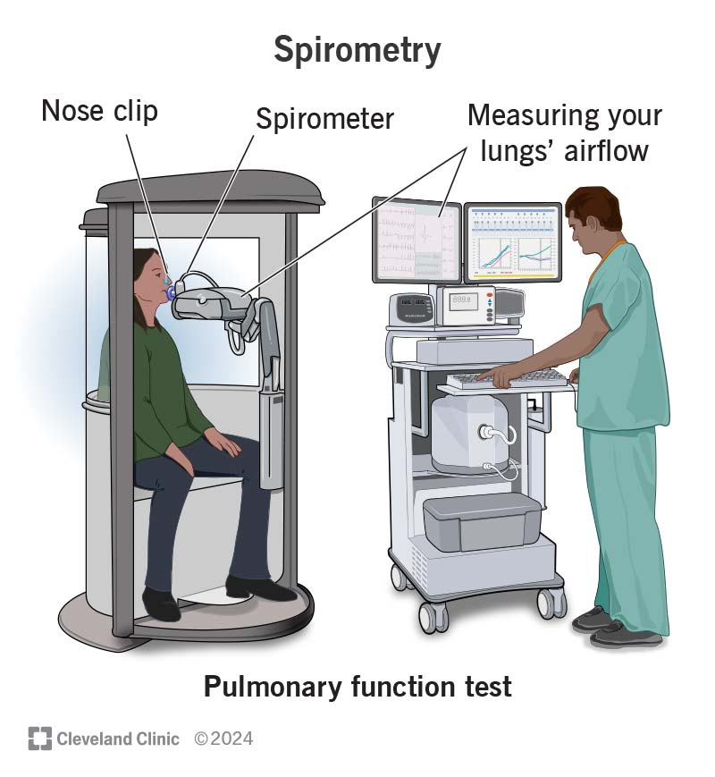
Group 3 Pulmonary Hypertension
6th WSPH (2018)
2022 ESC/ERS guidelines
The only PH group not defined by diseases
For example, restrictive lung diseases included diseases with very different mechanisms :
ILD / Pneumonectomy / Musculoskeletal disorders
Simonneau, Eur Respir J 2019; Humbert, Eur Respir J 2023

Slide 35
Group 3 Pulmonary Hypertension
3. PH associated with lung diseases and/or hypoxia
3.1 Chronic obstructive pulmonary disease and/or emphysema
3.2 Interstitial lung disease
3.3 Combined pulmonary fibrosis and emphysema
3.4 Other parenchymal lung diseases ^{b}
3.5 Non-parenchymal restrictive diseases
3.5.1 Hypoventilation syndromes
3.5.2 Pneumonectomy
3.5.3 Musculoskeletal disorders
3.6 Hypoxia without lung disease (e.g. high altitude)
3.7 Developmental parenchymal disorders
^{b} parenchymal lung diseases not included in Group 5

Slide 36
Group 4 Pulmonary Hypertension
4. PH associated with pulmonary artery obstructions
4.1 Chronic thromboembolic PH
4.2 Other pulmonary artery obstructions ^{c}
^{c} Other causes of pulmonary artery obstructions include:
sarcomas (high or intermediate grade or angiosarcoma), other malignant tumours (e.g. renal carcinoma, uterine carcinoma, germ-cell tumours of the testis), non-malignant tumours (e.g. uterine leiomyoma), arteritis without connective tissue disease, congenital pulmonary arterial stenoses, and hydatidosis

Slide 37
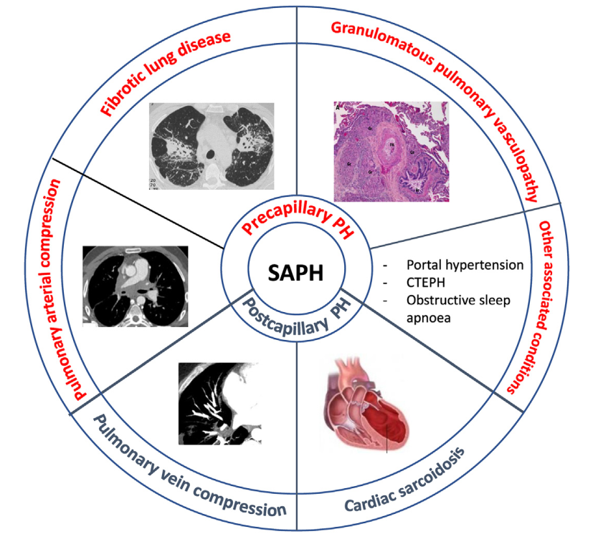
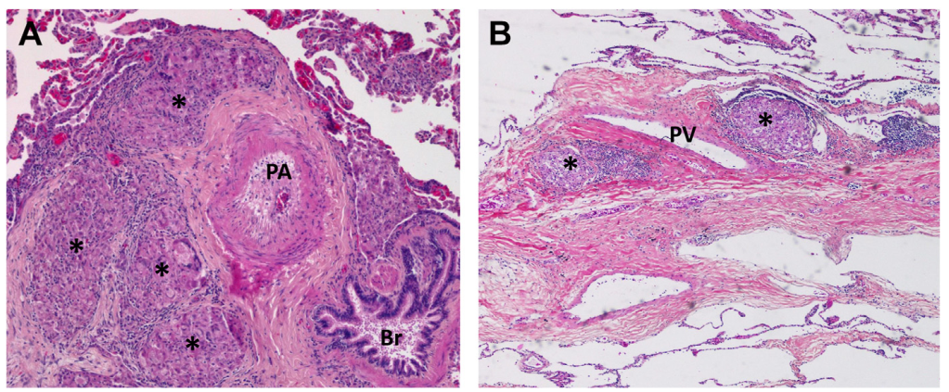
Group 5 Pulmonary Hypertension
GROUP 5 PH with unclear and/or multifactorial mechanisms
5.2 Systemic disorders: sarcoidosis, pulmonary Langerhans’s cell histiocytosis, and neurofibromatosis type 1
Savale, Clin Chest Med 2024

Slide 38
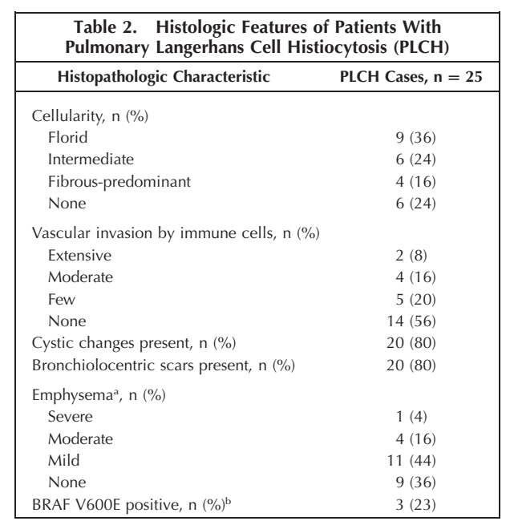
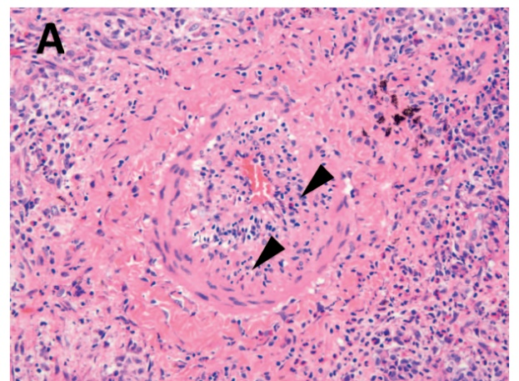
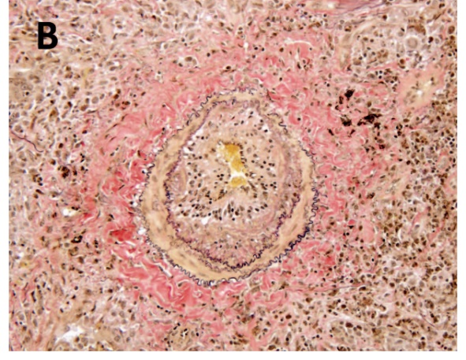
Group 5 Pulmonary Hypertension
GROUP 5 PH with unclear and/or multifactorial mechanisms
5.2 Systemic disorders: sarcoidosis, pulmonary Langerhans cell histiocytosis, and neurofibromatosis type 1
Le Pavec J, Chest 2012
Bois MC, Arch Pathol Lab Med 2018

Slide 39
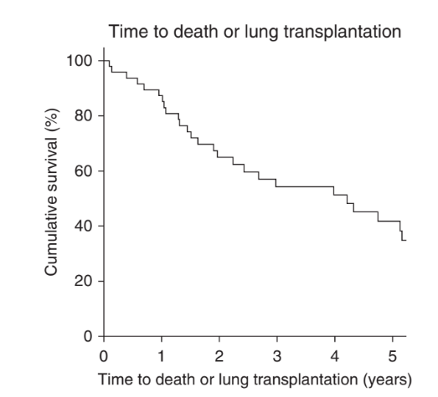
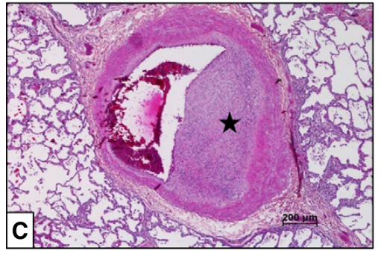
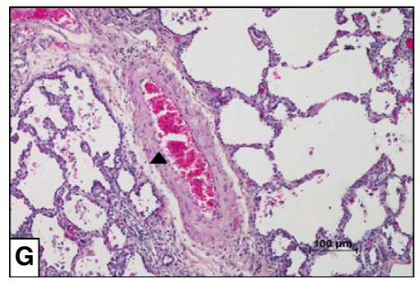
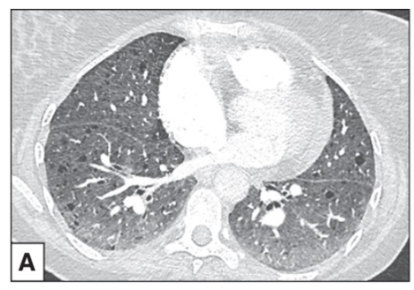
Group 5 Pulmonary Hypertension
GROUP 5 PH with unclear and/or multifactorial mechanisms
5.2 Systemic disorders: sarcoidosis, pulmonary Langerhans cell histiocytosis, and neurofibromatosis type 1
49 PH-NF1 cases (F:M 3.9)
Jutant EM, Am J Respir Crit Care Med 2023

Slide 40
Group 5 Pulmonary Hypertension
6th WSPH (2018)
2022 ESC/ERS guidelines

Slide 41
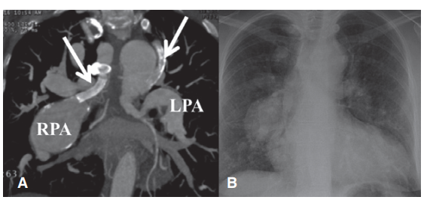
Group 5 Pulmonary Hypertension
5. PH with unclear and/or multifactorial mechanisms
5.1 Haematological disorders ^{d}
5.2 Systemic disorders: sarcoidosis, pulmonary Langerhans cell histiocytosis, and neurofibromatosis type 1
5.3 Metabolic disorders ^{e}
5.4 Chronic renal failure with or without haemodialysis
5.5 Pulmonary tumour thrombotic microangiopathy
5.6 Fibrosing mediastinitis
5.7 Complex congenital heart disease
Complex pulmonary atresia with segmental PAH

Slide 42
Diagnosis

Slide 43
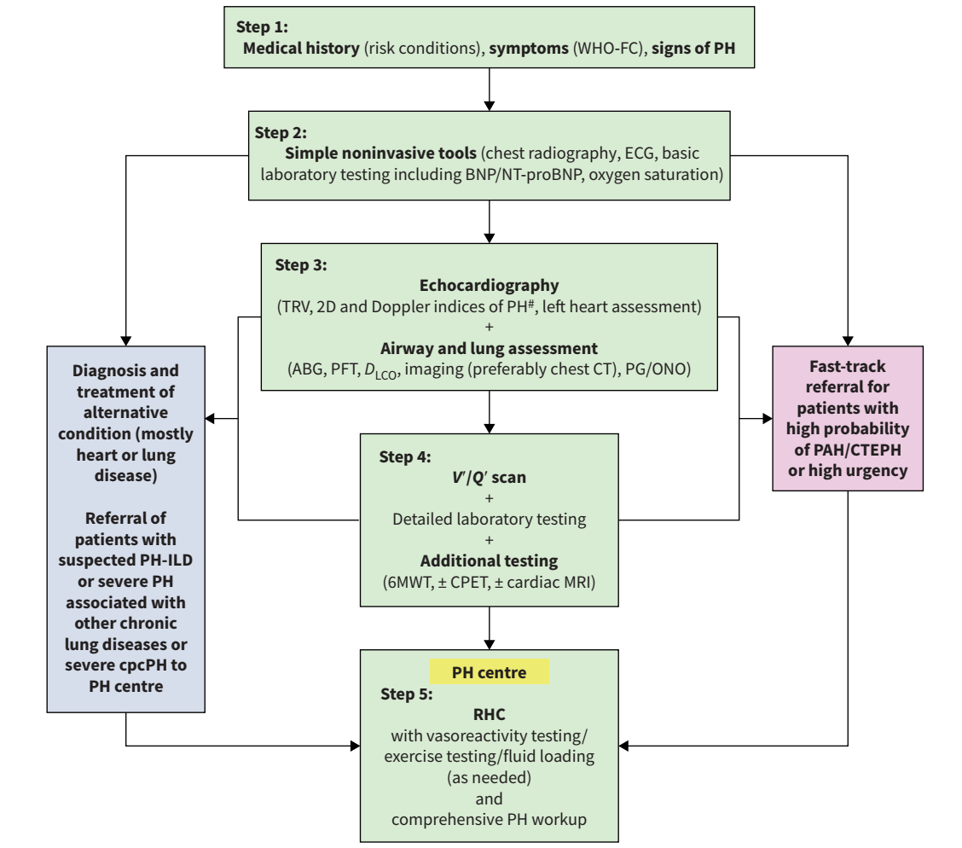
Diagnosis of PH

Slide 44
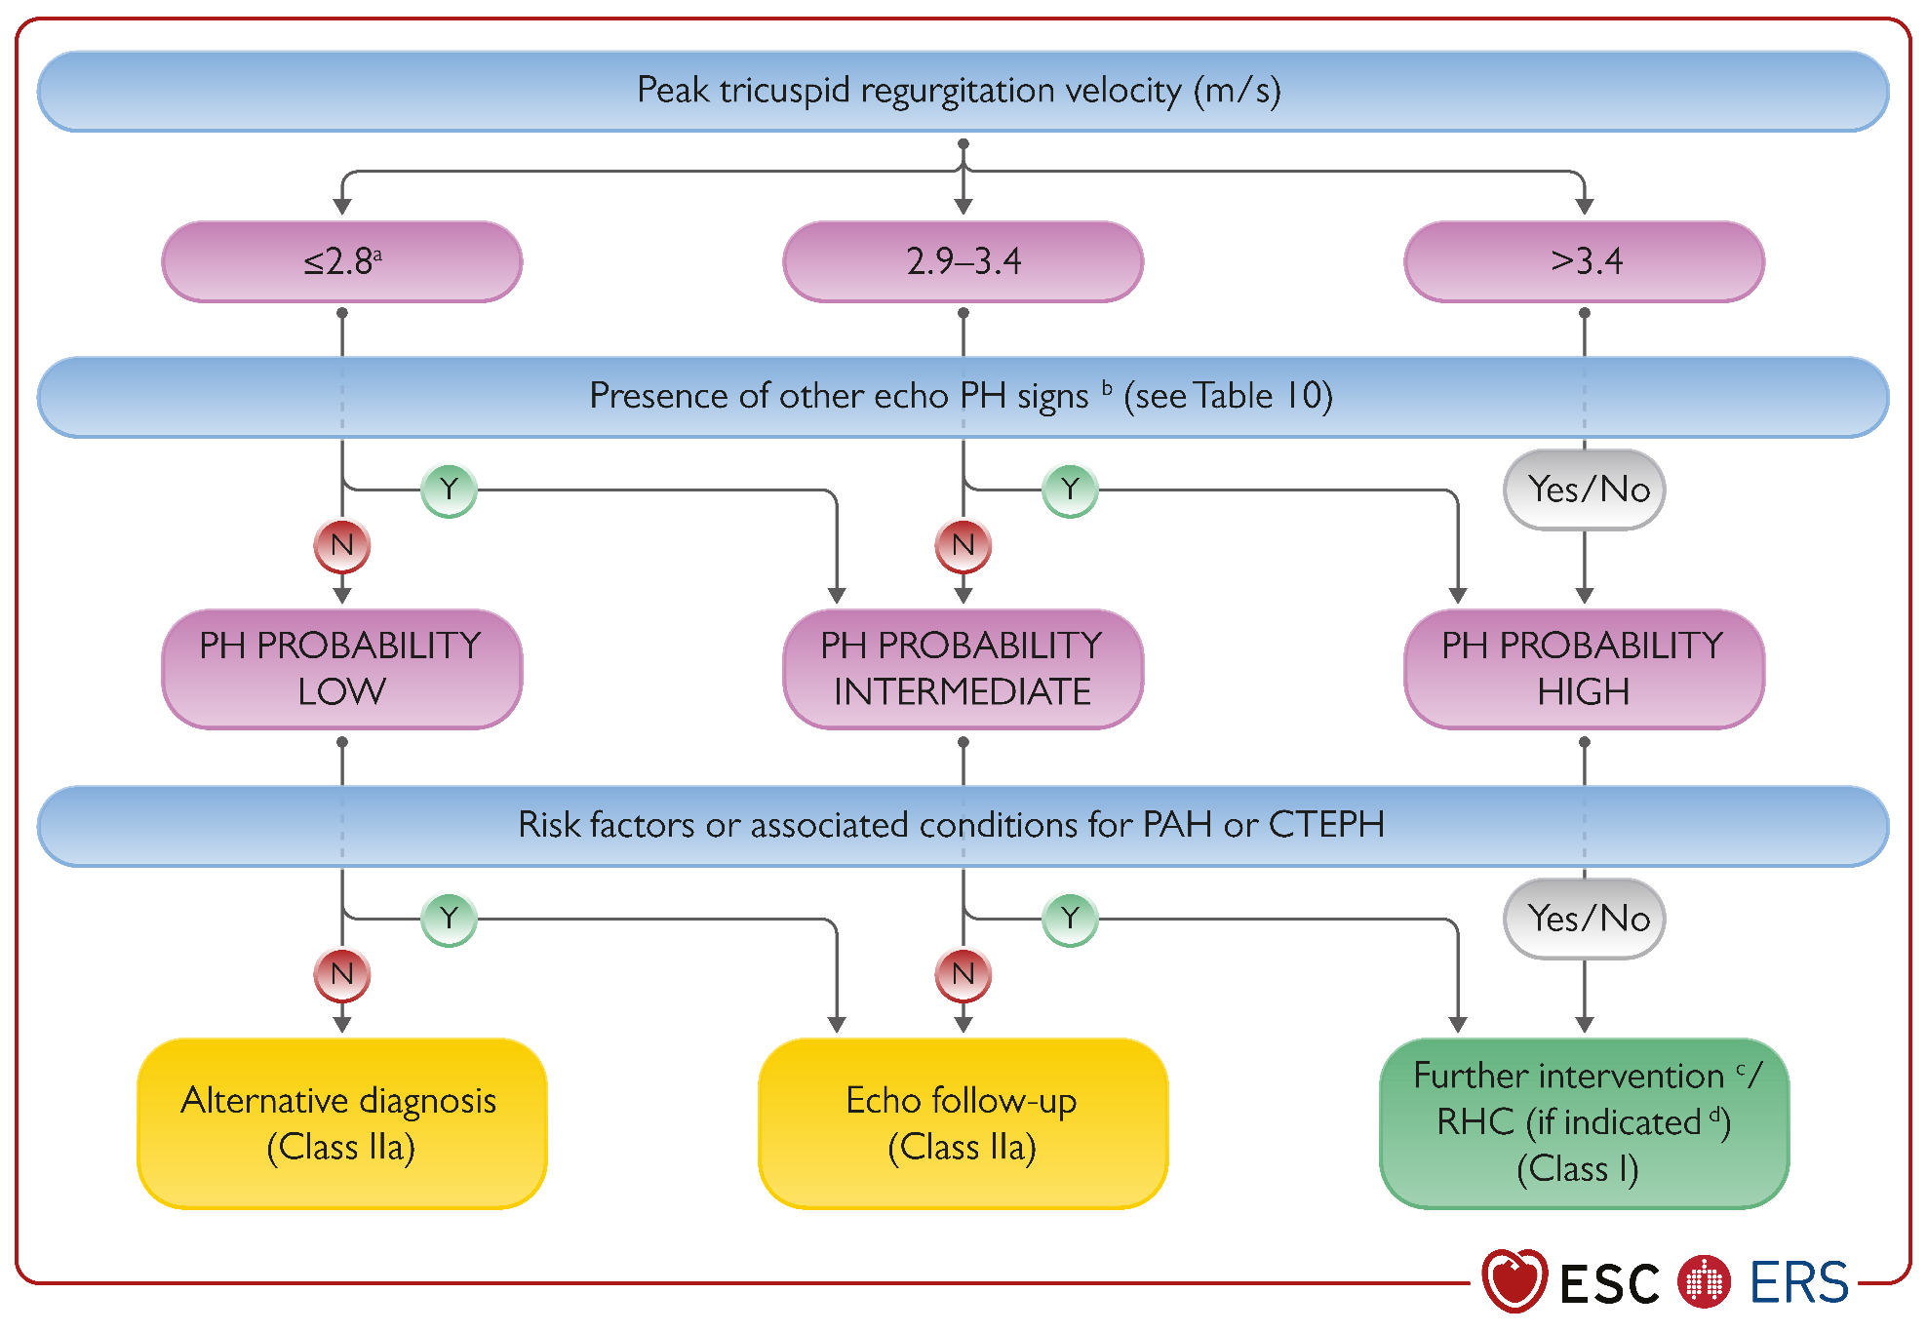
Echographic probability of PH
Guidelines 2022
TRV ++ (≤ 2.8 m/s, 2.9 – 3.4, > 3.4 m/s)
Humbert M et al. Eur Respir J 2022; in press: 2200879; Humbert M, et al. Eur Heart J 2022; 43: 3618-3731.

Slide 45
Echographic probability of PH
Guidelines 2022
TRV ++ (≤ 2.8 m/s, 2.9 – 3.4, > 3.4 m/s)
Presence of other PH signs
Humbert M et al. Eur Respir J 2022; in press: 2200879; Humbert M, et al. Eur Heart J 2022; 43: 3618-3731.

Slide 46
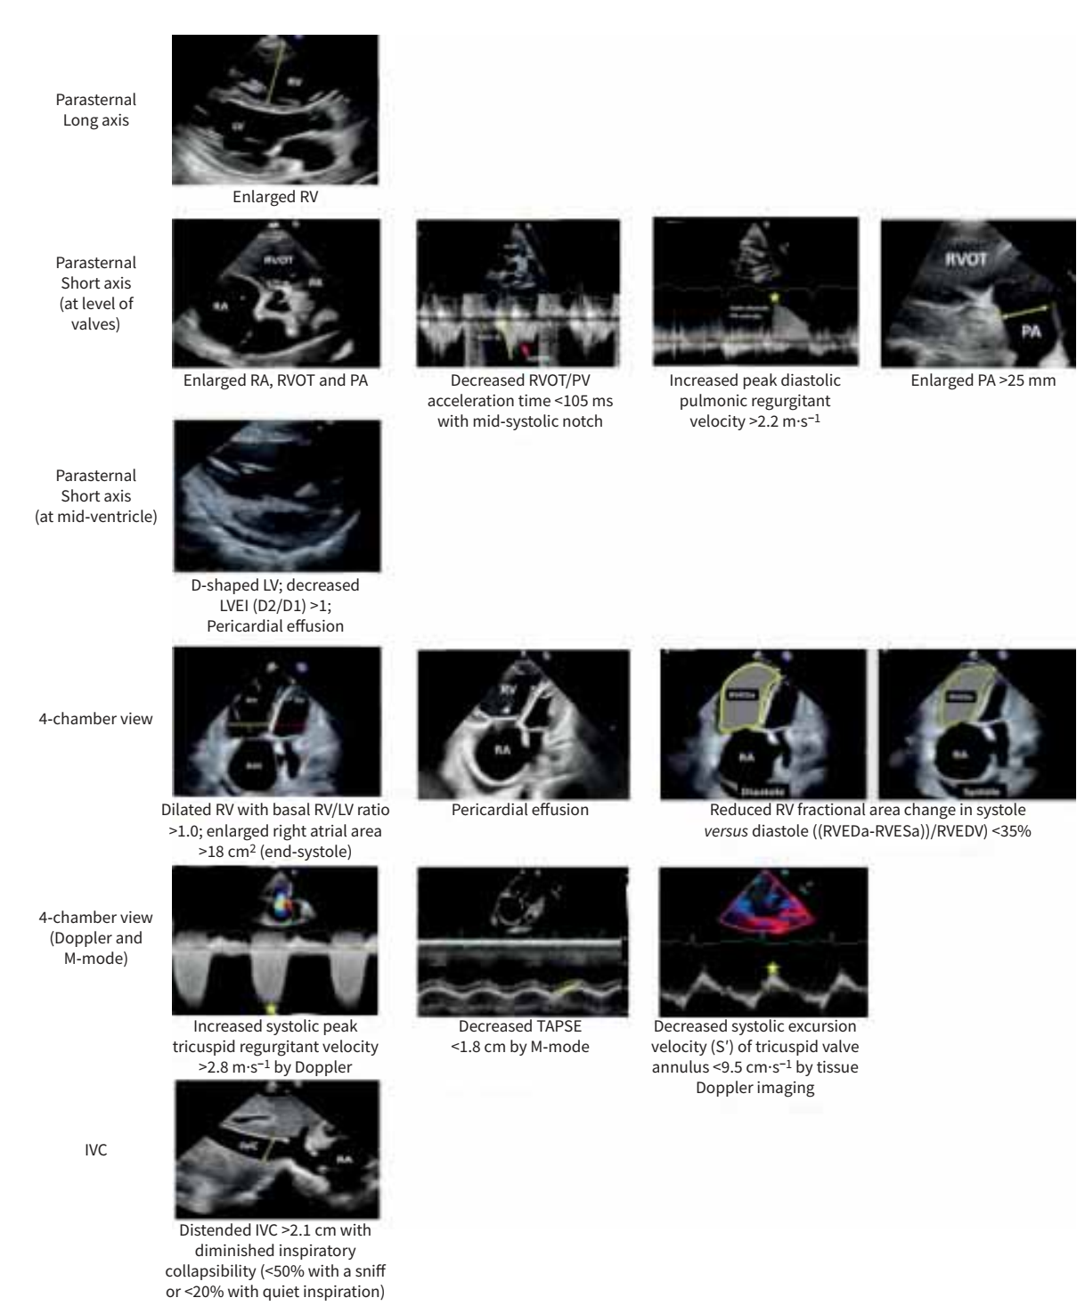
Echographic probability of PH

Slide 47
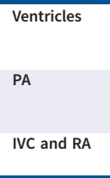
Echographic probability of PH

Slide 48
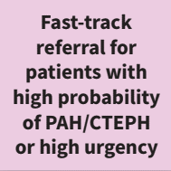
Diagnosis of PH

Slide 49
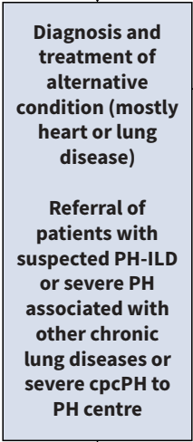
Diagnosis of PH

Slide 50
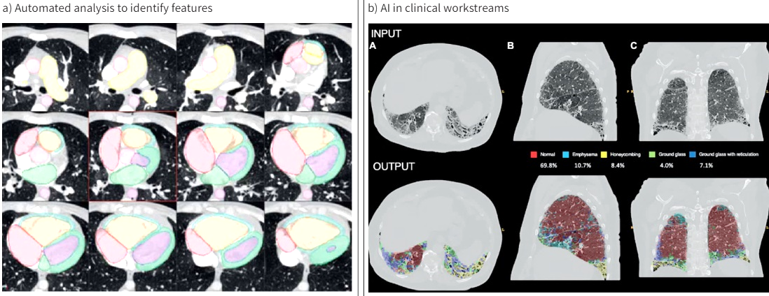
Emerging imaging techniques

Slide 51
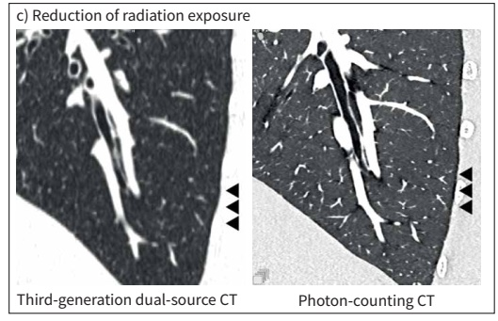
Emerging imaging techniques

Slide 52
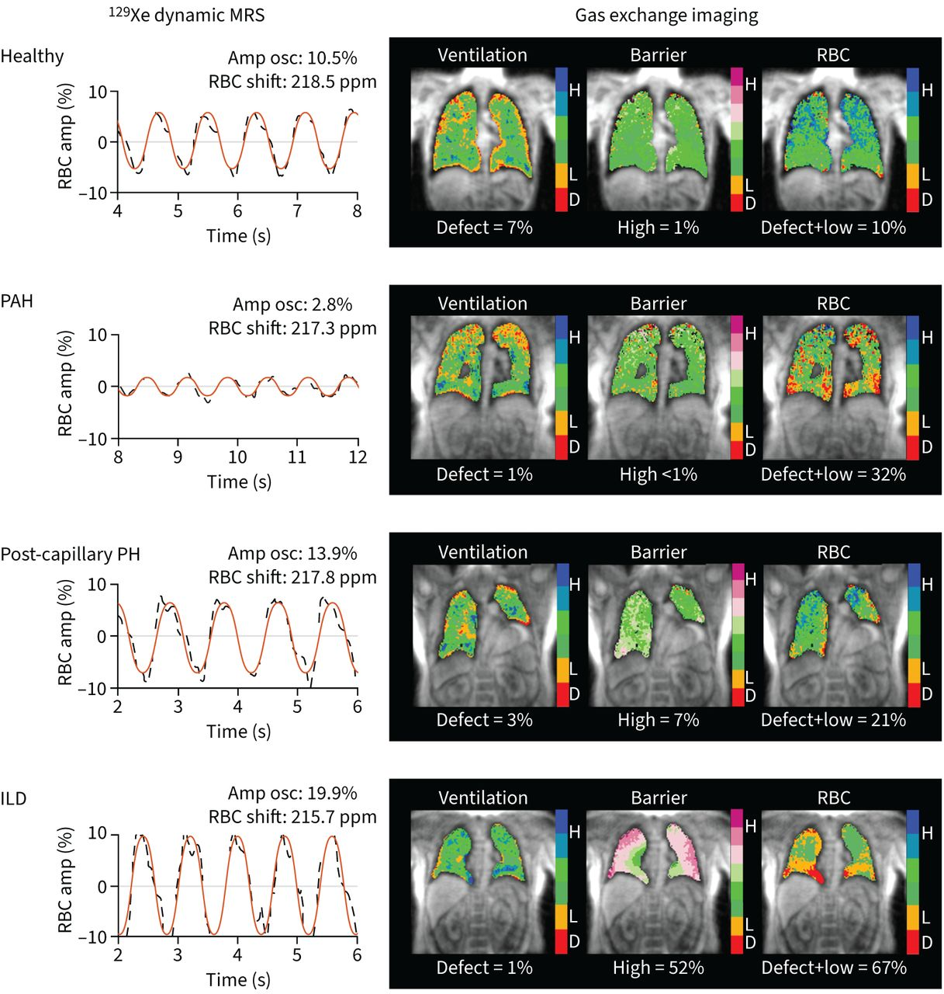
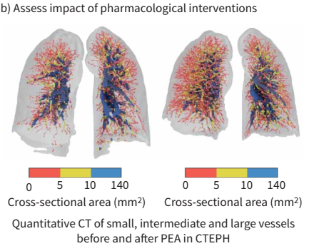
Emerging imaging techniques
hyperpolarised ¹²⁹Xe magnetic spectroscopy

Slide 53
﻿Pathophysiology and Genetics

Slide 54
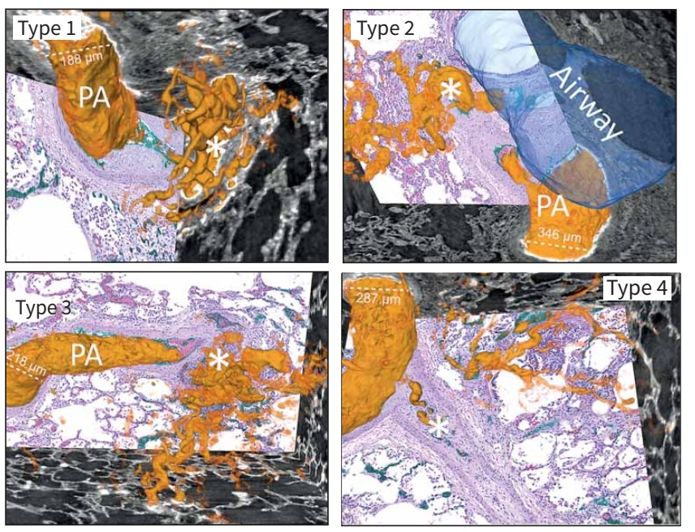
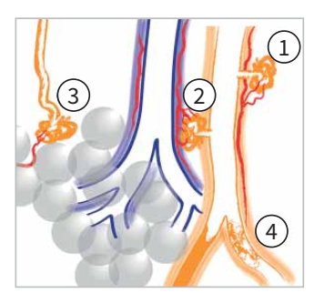
Pathophysiology

Slide 55
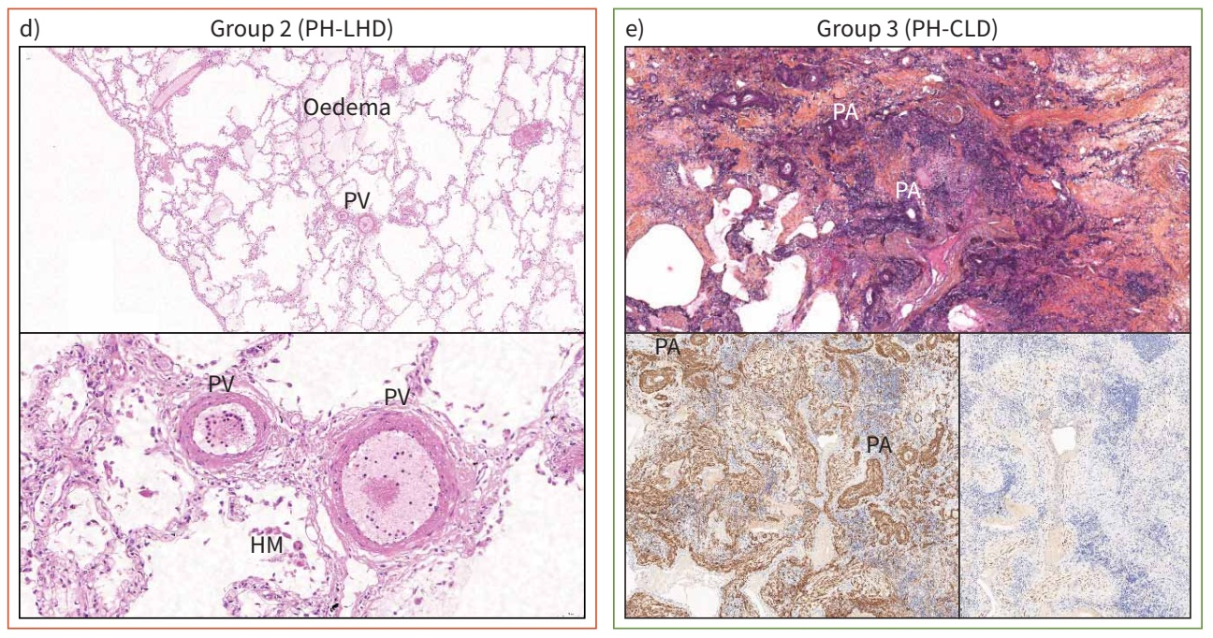
Pathophysiology

Slide 56
Pathophysiology

Slide 57
﻿Pathophysiology of the right ventricle and its pulmonary vascular interaction

Slide 58
Burden of rare variants in PAH

Slide 59
Utility of genetic testing

Slide 60
Recommendations for genetic testing

Slide 61
Utility of genetic testing

Slide 62
Utility of genetic testing

Slide 63
Precision Medicine

Slide 64
﻿ Risk stratification in PAH

Slide 65
Evolution of the disease : Risk stratification

Slide 66
Evolution of the disease : Risk stratification at baseline

Slide 67
Evolution of the disease : Risk stratification

Slide 68
Evolution of the disease : Risk stratification during follow-up

Slide 69
Treatment goals

Slide 70
﻿ Treatment algorithm in PAH

Slide 71
Supportive measures

Slide 72
Innovative therapy: Targeting Activin/BMP pathway

Slide 73
Three main signalling pathways involving PA endothelial and smooth muscle cells are dysfunctional in PAH
Vessel¹
Therapeutic pathways²
Endothelin pathway
Nitric oxide
pathway
Prostacyclin
pathway
Endothelium
Pro-
endothelin-1
Endothelin-1
Selective ERA (ambrisentan)
Dual ERA
(bosentan, macitentan)
L-arginine
Arachidonic acid
Prostacyclin
Nitric oxide
Prostacyclin analogs (epoprostenol, treprostinil, iloprost)
Non-prostanoid IP receptor agonist (selexipag)
ET_{B}
sGC stimulator (riociguat)
ET_{A}
Y
PDE-5 inhibitors (sildenafil, tadalafil)
Y
IP receptor
sGC
PDE-5
Y
GTP
cGMP
GMP
cAMP
Smooth muscle cell
Vasoconstriction and proliferation
Vasodilation and anti-proliferation
Vasodilation and anti-proliferation
cAMP: cyclic adenosine monophosphate; cGMP: cyclic guanidine monophosphate; ERA: endothelin receptor antagonist; ET: endothelin; GMP: guanidine monophosphate; GTP; guanidine triphosphate; IP: prostacyclin; PAH: pulmonary arterial hypertension; PDE: phosphodiesterase; sGC: soluble guanylate cyclase.
1. Adapted from Pugliese S, et al. Am J Physiol Lung Cell Mol Physiol 2015; 308:L229–52; 2. Lau EMT, et al. Nat Rev Cardiol 2017; 14:603-14.

Slide 74
Innovative therapy: Targeting Activin/BMP pathway

Slide 75
Restoring the BMPR-II/Activin Receptor IIA (ActRIIA) Balance in PAH
PAH
Sotatercept
Humbert et al. N Engl J Med 2021

Slide 76
PULSAR (phase 2 study)
24-week study
subcutaneous sotatercept at a dose of 0.3 mg/Kg, 0.7 mg/Kg or placebo every 3 weeks
n=106, 37% on parenteral PGI₂; 56% on triple combination therapy
Primary endpoint
significant reduction in PVR
Significant improvements in key secondary EP
6MWD: treatment effect +21.4 m (0.7 mg/kg)
NT-proBNP
Functional class
Sotatercept was well tolerated and AEs were consistent with previously published data (thrombocytopenia and increase in Hb level)
Humbert et al. N Engl J Med 2021
Sotatercept is an investigational product that is not approved in France

Slide 77
PULSAR (phase 2 study)
Humbert et al. N Engl J Med 2021
Sotatercept is an investigational product that is not approved in France

Slide 78
Pulmonary vascular resistance
placebo
Sotatercept
Sotatercept
Humbert et al. Eur Respir J 2023

Slide 79
6-minutes walk distance
placebo
Sotatercept
Sotatercept
Humbert et al. Eur Respir J 2023

Slide 80
90% of patients in FC I-II on sotatercept after 18–24 months
placebo
Sotatercept
Sotatercept
Humbert et al. Eur Respir J 2023

Slide 81
STELLAR
6-minutes walk distance at W24
24-week study
NYHA FC II-III (≈ 50/50)
SC sotatercept : target dose 0.7 mg/Kg
n=323
40% on parenteral PGI₂; 61% on triple combination therapy
+34 m
-1 m
Hoeper et al. NEJM 2023

Slide 82
STELLAR
Secondary endpoints
24-week study
NYHA FC II-III (≈ 50/50)
SC sotatercept : target dose 0.7 mg/Kg
n=323
40% on parenteral PGI₂; 61% on triple combination therapy
8 secondary end points, tested hierarchically were significant:
multicomponent improvement (6-MWD, NTproBNP, WHO FC)
change in pulmonary vascular resistance
change in NT-proBNP
improvement in WHO functional class
time to death or clinical worsening
French risk score
changes in the PAH-SYMPACT
Hoeper et al. NEJM 2023

Slide 83
STELLAR: ﻿Time to First Occurrence of Death or Nonfatal Clinical Worsening Event
Hoeper MM, et al. N Engl J Med, published on March 6, 2023, at NEJM.org. DOI: 10.1056/NEJMoa2213558.

Slide 84
STELLAR: A phase 3 trial of sotatercept for treatment of PAH
The safety profile of sotatercept was consistent with consistent with that observed in the phase 2 PULSAR trial including its extension study
Thrombocytopenia
Increase in Hb level
The most notable side effects were telangiectasia and bleeding (mainly epistaxis and gingival bleeding)
Hoeper MM, et al. N Engl J Med, published on March 6, 2023, at NEJM.org. DOI: 10.1056/NEJMoa2213558.

Slide 85
Available therapies in PAH

Slide 86
Treatment algorithm

Slide 87
Treatment algorithm

Slide 88
Treatment algorithm

Slide 89
Treatment algorithm

Slide 90
Ongoing or recently completed phase 2 and phase 3 clinical trials

Slide 91
Win statistics for composite endpoints in PAH trials

Slide 92
Platform trials for PAH

Slide 93
Trial designs to evaluate disease modification

Slide 94
﻿ Pulmonary hypertension associated with left heart disease

Slide 95
Group 2 Pulmonary Hypertension
6th WSPH (2018)
2022 ESC/ERS guidelines
Simonneau, Eur Respir J 2019; Humbert, Eur Respir J 2023

Slide 96
Group 2 Pulmonary Hypertension
2. PH associated with left heart disease
2.1 Heart failure:
2.1.1 with preserved ejection fraction
2.1.2 with reduced or mildly reduced ejection fraction
2.1.3 with specific cardiomyopathies (hypertrophic and amyloid)
2.2 Valvular heart disease
2.2.1 aortic valve disease
2.2.2 mitral valve disease
2.2.3 mixed valvular disease
2.3 Congenital/acquired cardiovascular conditions leading to post-capillary PH
Different incidence, pathophysiology and potential specific management

Slide 97
Left heart disease comorbidity staging

Slide 98
Clinical stage of PH-LHD
Clinical Trials
+++

Slide 99
﻿ Pulmonary hypertension associated with lung diseases

Slide 100
Group 3 Pulmonary Hypertension: Classification
6th WSPH (2018)
2022 ESC/ERS guidelines
The only PH group not defined by diseases
For example, restrictive lung diseases included diseases with very different mechanisms :
ILD / Pneumonectomy / Musculoskeletal disorders
Simonneau, Eur Respir J 2019; Humbert, Eur Respir J 2023

Slide 101
Major components of the updated classification of group 3 PH

Slide 102
Group 3 Pulmonary Hypertension: Classification
3. PH associated with lung diseases and/or hypoxia
3.1 Chronic obstructive pulmonary disease and/or emphysema
3.2 Interstitial lung disease
3.3 Combined pulmonary fibrosis and emphysema
3.4 Other parenchymal lung diseases ^{b}
3.5 Non-parenchymal restrictive diseases
3.5.1 Hypoventilation syndromes
3.5.2 Pneumonectomy
3.5.3 Musculoskeletal disorders
3.6 Hypoxia without lung disease (e.g. high altitude)
3.7 Developmental parenchymal disorders
^{b} parenchymal lung diseases not included in Group 5

Slide 103
Group 5 Pulmonary Hypertension
GROUP 5 PH with unclear and/or multifactorial mechanisms
5.2 Systemic disorders: sarcoidosis, pulmonary Langerhans’s cell histiocytosis, and neurofibromatosis type 1
Savale, Clin Chest Med 2024

Slide 104
Group 5 Pulmonary Hypertension
GROUP 5 PH with unclear and/or multifactorial mechanisms
5.2 Systemic disorders: sarcoidosis, pulmonary Langerhans cell histiocytosis, and neurofibromatosis type 1
Le Pavec J, Chest 2012
Bois MC, Arch Pathol Lab Med 2018

Slide 105
Group 5 Pulmonary Hypertension
GROUP 5 PH with unclear and/or multifactorial mechanisms
5.2 Systemic disorders: sarcoidosis, pulmonary Langerhans cell histiocytosis, and neurofibromatosis type 1
49 PH-NF1 cases (F:M 3.9)
Jutant EM, Am J Respir Crit Care Med 2023

Slide 106
Group 5 Pulmonary Hypertension
5. PH with unclear and/or multifactorial mechanisms
5.1 Haematological disorders ^{d}
5.2 Systemic disorders: sarcoidosis, pulmonary Langerhans cell histiocytosis, and neurofibromatosis type 1
5.3 Metabolic disorders ^{e}
5.4 Chronic renal failure with or without haemodialysis
5.5 Pulmonary tumour thrombotic microangiopathy
5.6 Fibrosing mediastinitis
5.7 Complex congenital heart disease

Slide 107
Group 3 Pulmonary Hypertension: Diagnosis

Slide 108
Group 3 Pulmonary Hypertension: Diagnosis

Slide 109
PATHOPHYSIOLOGY of PH in group 3 PH
Cluster analysis
Kovacs, AJRCCM 2018
Nathan, Eur Respir J 2019
Thabut G. et al. Chest 2005

Slide 110
PATHOPHYSIOLOGY of PH in group 3 PH
Cluster analysis
Kovacs, AJRCCM 2018
Nathan, Eur Respir J 2019
Thabut G. et al. Chest 2005

Slide 111
PATHOPHYSIOLOGY of PH in group 3 PH
Cluster analysis
Severe PH (PVR > 5 WU)
Kovacs, AJRCCM 2018
Nathan, Eur Respir J 2019
Thabut G. et al. Chest 2005

Slide 112
Framework for management of ILD-PH

Slide 113
Inhaled Treprostinil in PH-ILD
FVC <70%
PAPm > 25 mmHg, PVR > 3 WU
Primary endpoint
6-MWD at Week 16
Waxman et al, NEJM 2021

Slide 114
Inhaled Treprostinil in PH-ILD
Inhaled treprostinil is not authorized in Europe
Waxman et al, NEJM 2021

Slide 115
Inhaled Treprostinil in PH-ILD
Inhaled treprostinil is not authorized in Europe
Waxman et al, NEJM 2021

Slide 116
Inhaled Treprostinil in PH-ILD
Pending issues - INCREASE Study
Efficacy in patients with mild PH ?
Efficacy in patients with cardiac comorbidities ?
In INCREASE trial, patients were excluded if they have :
- PAWP > 12 mmHg and PVR < 6.25 WU
- or LVEF < 40%
- or > 3 risk factors for LV disease
Inhaled treprostinil is not authorized in Europe
Waxman et al, NEJM 2021

Slide 117
Inhaled Treprostinil in PH-ILD
Waxman et al, Eur Respir J 2023
Waxman et al, Eur Respir J 2023

Slide 118
Inhaled Treprostinil in PH-ILD
INCREASE Open Label Extension Study
6-MWD
Waxman et al, Eur Respir J 2023

Slide 119
Inhaled Treprostinil in PH-ILD
INCREASE Open Label Extension Study
FVC
Waxman et al, Eur Respir J 2023

Slide 120
PH-COPD

Slide 121
Severe PH COPD
PHRC ERASE-PH COPD 2023
Tadalafil (IPDE5) versus placebo
200 severe PH-COPD patients
Efficacy and Safety
Inclusion criteria: - 18-80 y
- FEV1 30-80%
- PVR > 5WU
- naive from PAH-approved drugs

Slide 122
﻿ Chronic thromboembolic pulmonary disease

Slide 123
Group 4 Pulmonary Hypertension
4. PH associated with pulmonary artery obstructions
4.1 Chronic thromboembolic PH
4.2 Other pulmonary artery obstructions ^{c}
^{c} Other causes of pulmonary artery obstructions include:
sarcomas (high or intermediate grade or angiosarcoma), other malignant tumours (e.g. renal carcinoma, uterine carcinoma, germ-cell tumours of the testis), non-malignant tumours (e.g. uterine leiomyoma), arteritis without connective tissue disease, congenital pulmonary arterial stenoses, and hydatidosis

Slide 124
CTEPD imaging modalities

Slide 125
Treatment targets in CTEPH
Proximal fibrotic lesions:
Main, lobar, segmental pulmonary arteries
Distal fibrotic lesions:
Sub-segmental and more distal PA up to 3 mm diameter
Small vessels disease (similar to those found in IPAH): Thickening of small PA wall (0.1 to 0.5 mm diameter)
Humbert M, et al. Eur Respir J 2022; in press: 2200879; Humbert M, et al. Eur Heart J 2022; 43: 3618-3731.

Slide 126
Principes de l’angioplastie pulmonaire
Angiographie sélective
Dilatation au ballon
Résultat après dilatation

Slide 127
CTEPH treatment algorithm

Slide 128
Multimodal treatment of CTEPH : objective Recovery !

Slide 129
Objectives: recovery !

Slide 130
﻿ Conclusions

Slide 131
Conclusions
New classification based on the same architecture

Slide 132
Conclusions
New classification based on the same architecture
No change in the hemodynamic definition: mPAP 20 mmHg, PVR 2 WU, PAWP 15 mmHg
Definition | Haemodynamic characteristics
PH | mPAP >20 mmHg
Pre-capillary PH | mPAP >20 mmHg PAWP ≤15 mmHg PVR >2 WU
Isolated post-capillary PH | mPAP >20 mmHg PAWP >15 mmHg PVR ≤2 WU
Combined post- and pre-capillary PH | mPAP >20 mmHg PAWP >15 mmHg PVR >2 WU

Slide 133
Conclusions
New classification based on the same architecture
No change in the hemodynamic definition: mPAP 20 mmHg, PVR 2 WU, PAWP 15 mmHg
Importance of Risk assesment to guide the treatment : ERS/ESC 3-strata and 4-strata
Inclusion of Sotatercept in treatment algorithm for PAH
Group 2 : need for clinical trials
PH-ILD : inhaled treprostinil may represent a therapeutic option
PH-COPD: 2 clinicals trials (inhaled MK-5475-013 and tadalafil)
CTEPH : The objective is now to normalize hemodynamics and to reach normal survival

Slide 134
﻿Actualités dans l’Hypertension Pulmonaire Retour du 7th WSPH
SPIF
Paris 2024
Pr David MONTANI
Centre Coordonnateur du CRMR PulmoTension, Service de Pneumologie et Soins Intensifs Respiratoires Hôpital Bicêtre (APHP) – Université Paris-Saclay – INSERM UMR_S999 Le Kremlin-Bicêtre – France

Slide 135
﻿ Back-up Slides

Slide 136
Acute decompensated PH

Slide 137
Indications for referral and listing forLTx

Slide 138
Manage surgery

Slide 139
Pregnancy

Slide 140
Palliative care

